Slide 1
ARTIST TRADING CARDS

Slide 2
ATC Requirements
Always 2.5” by 3.5”
All media is acceptable
Sign and Title your work
(on the back)
Always Traded
Never Sold

Slide 3
You will be creating a series of work . That means: Make multiple cards based on a theme.

Slide 4
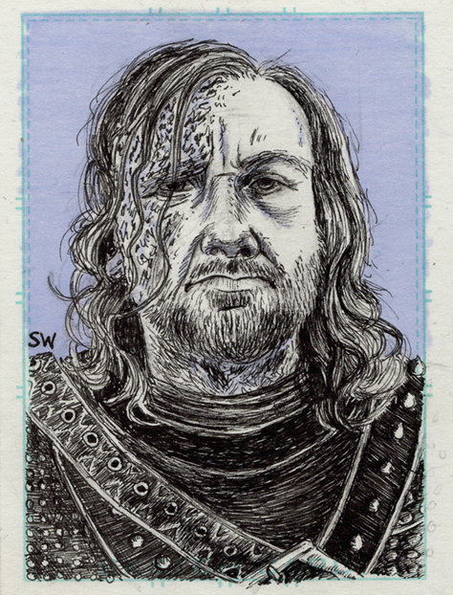
Each card needs a background and foreground.

Slide 5
Add a word or phrase.

Slide 6
Add layers.

Slide 7
Add an embellishment.

Slide 8
Make an Envelope for Your Cards

Slide 9
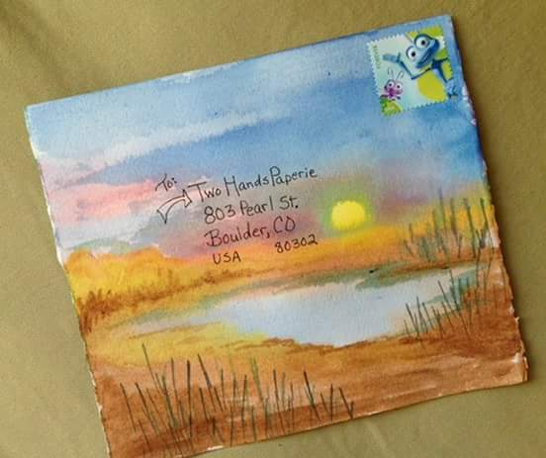

Slide 12
