Slide 1
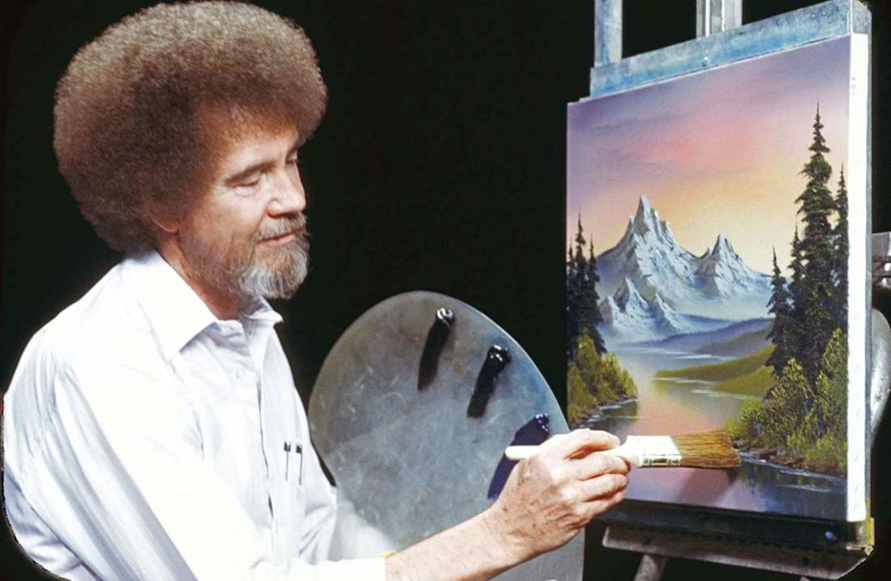
Bob Ross Inspired Landscape Painting

Slide 2
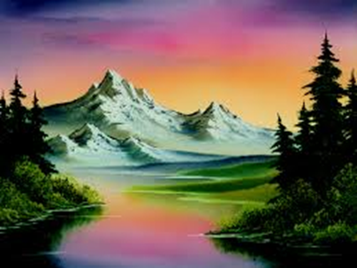

Slide 3
Known for his sayings:

Slide 5
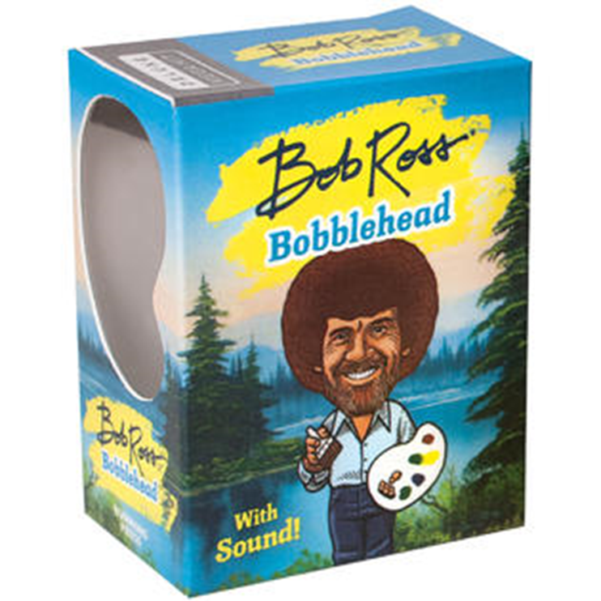
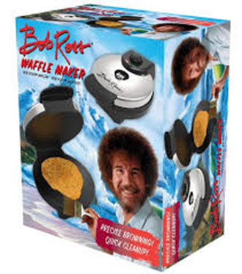

Slide 7
Elements of a Landscape:
Mountains
Valleys
Trees
Streams
Lakes
Rocks
Twigs
Grasses
Bushes
Cacti
Islands
Sunsets
Clouds
Cabins

Slide 8
Things to Consider:
Light Direction (keep consistent)
Proportion (smaller as object gets further away)
And…
Foreground (closest to viewer)
+Middle Ground (further away from viewer)
+Background (furthest away from viewer)
=Depth (illusion of space)

