Slide 1
Changing Background
Will Schafer

Slide 2
You want to start with the image that you’re going to put on a different background.

Slide 3
Next you want to cut out that image by using the auto-selection tool, lasso tool, or any other method of cutting out the image.

Slide 4
Next you want to copy and paste the image onto your new background.

Slide 5
Then make a copy of the background layer by right clicking on the background layer and pressing duplicate

Slide 6
Next you want to select the image that you copied into the document and Select the Pixels by right clicking on the area outlined in red then selecting the button that says Select Pixels

Slide 7
Next click on the background layer with the pixels still selected and press the backspace button to delete the original dog.

Slide 8
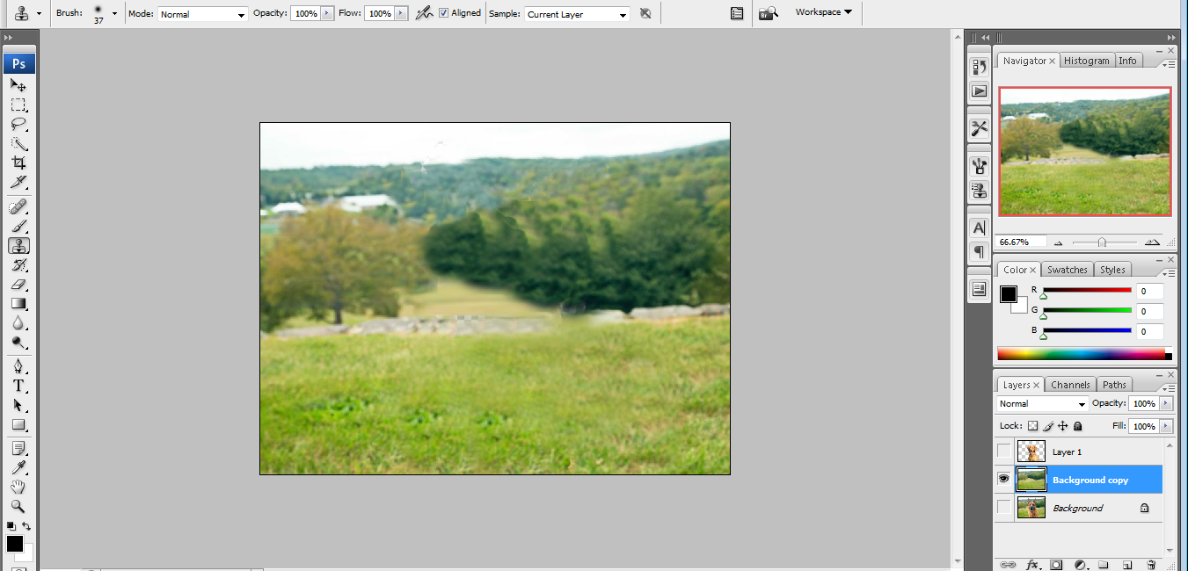
Next you want to use the clone stamp tool to fill in the blank area

Slide 9
Then you can just make the layer visible and now it is on a different background.

