Slide 1
Face Jugs

Slide 2
FACE JUG HISTORY
Slave communities in the early 1800’s.
Popular folk art tradition of the Southeastern U.S.
Had to be ugly enough to frighten the devil.
Prohibition-scary faces on jugs to frighten children- moonshine jugs.
Known as ugly jugs, devil jugs and voodoo pots.

Slide 3
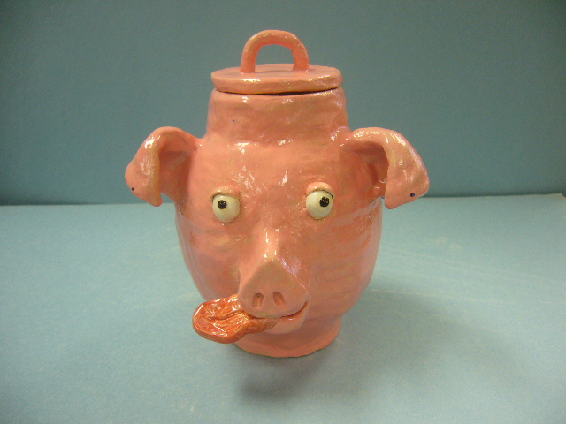

Slide 4
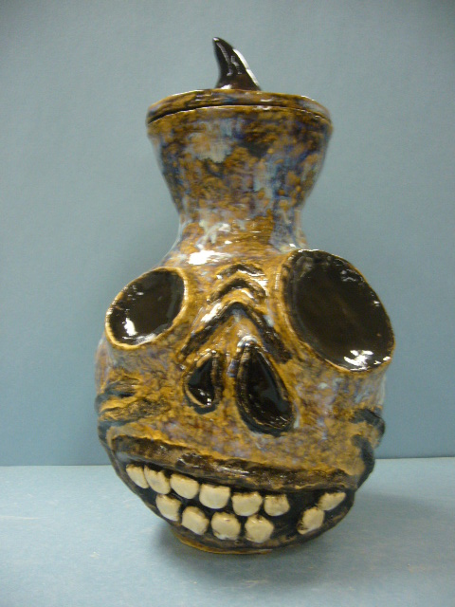

Slide 5
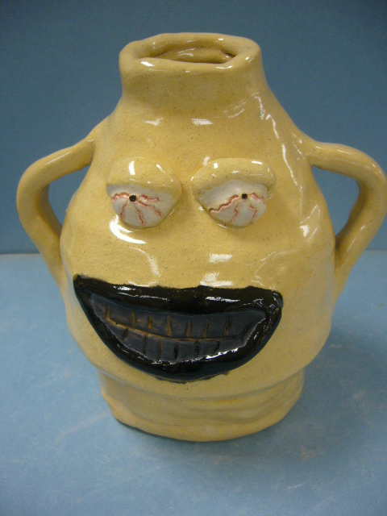

Slide 6
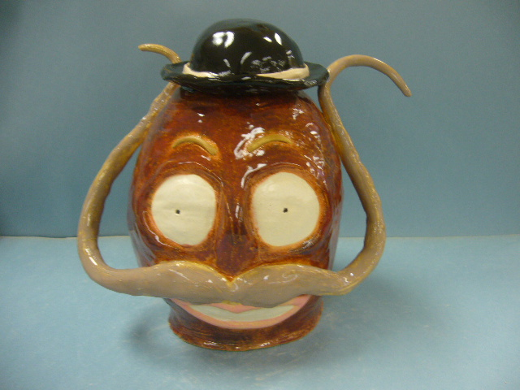

Slide 7
CRITERIA:
Use coil construction to make the jug.
Add facial features using score, slip & wiggle
Carve details
Must have Handles and/or Lid
Must be 8”-12” tall

