Slide 1
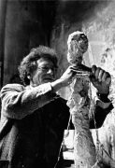
Figure Sculptures
Based on the work by
Alberto Giacometti

Slide 2
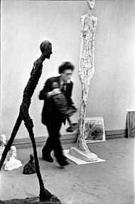
1901-1966
Switzerland
Surrealism & Expressionism
Bronze sculpture
He attempted to create renditions
of his models the way he saw them,
and the way he thought they ought to be seen. He once said that he was sculpting not the human figure but "the shadow that is cast.“

Slide 3
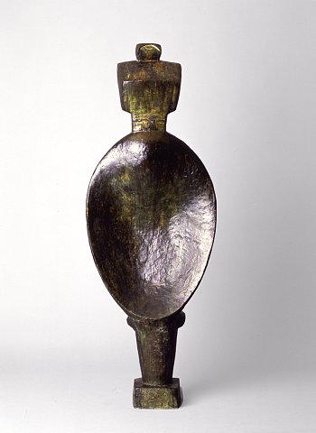
Spoon Woman, 1926, was Giacometti’s first bronze sculpture.

Slide 4
Grande Femme Debout II was bought by the Gagosian Gallery for $27.4 million at Christie’s auction in New York City on May 6, 2008.

Slide 5
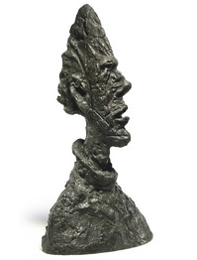
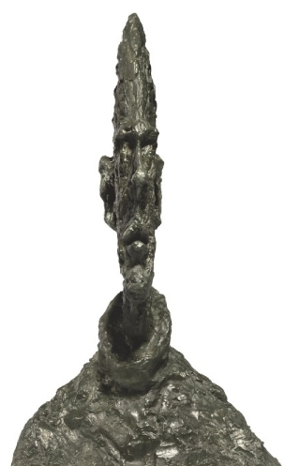
Grande tete mince, a large bronze bust, recently sold for $53.3 million.

Slide 6
L’Homme qui marche I, a life-sized bronze sculpture of a man, became one of the most expensive works of art and the most expensive sculpture ever sold at auction on February 2, 2010 when it sold for $104.3 million at Sotheby’s, London.

Slide 7
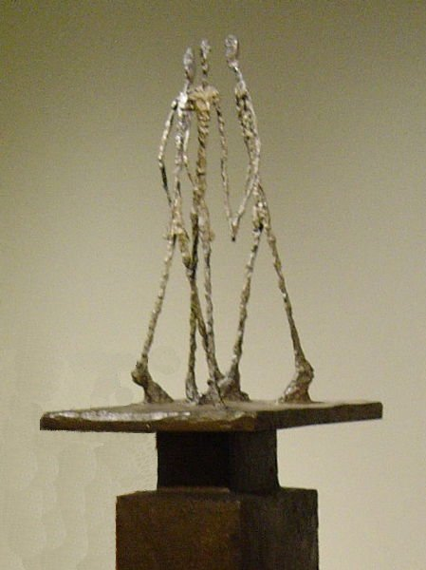
Three Men Walking II, 1949

Slide 8
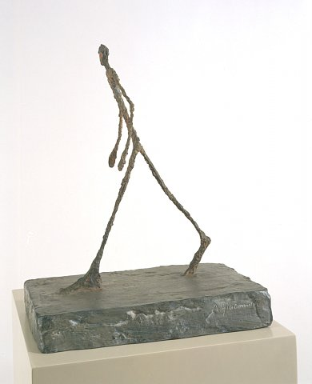
Man Crossing a Square, 1949

Slide 9
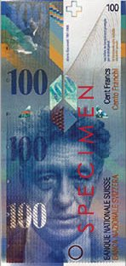
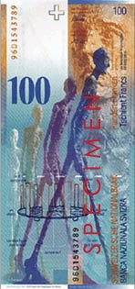
Giacometti and his sculpture L'Homme qui marche I appear on the current 100 Swiss Franc banknote.

Slide 10
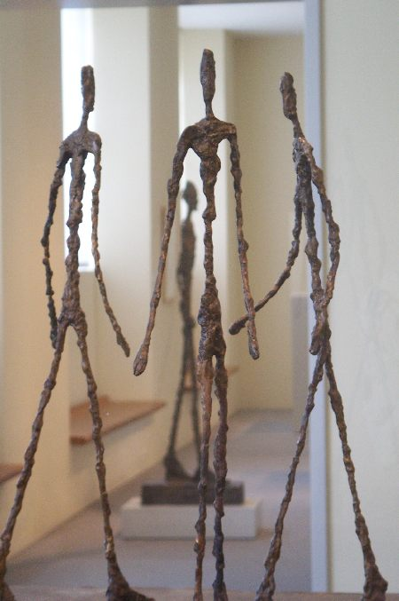
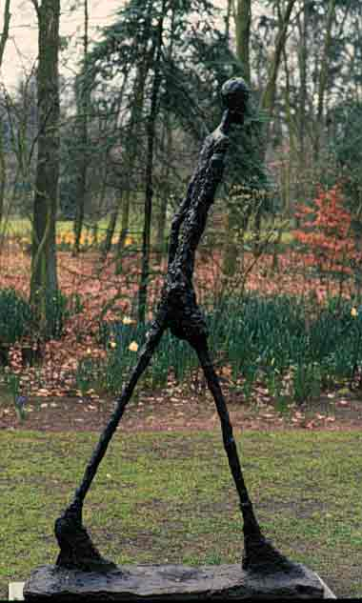

Slide 11
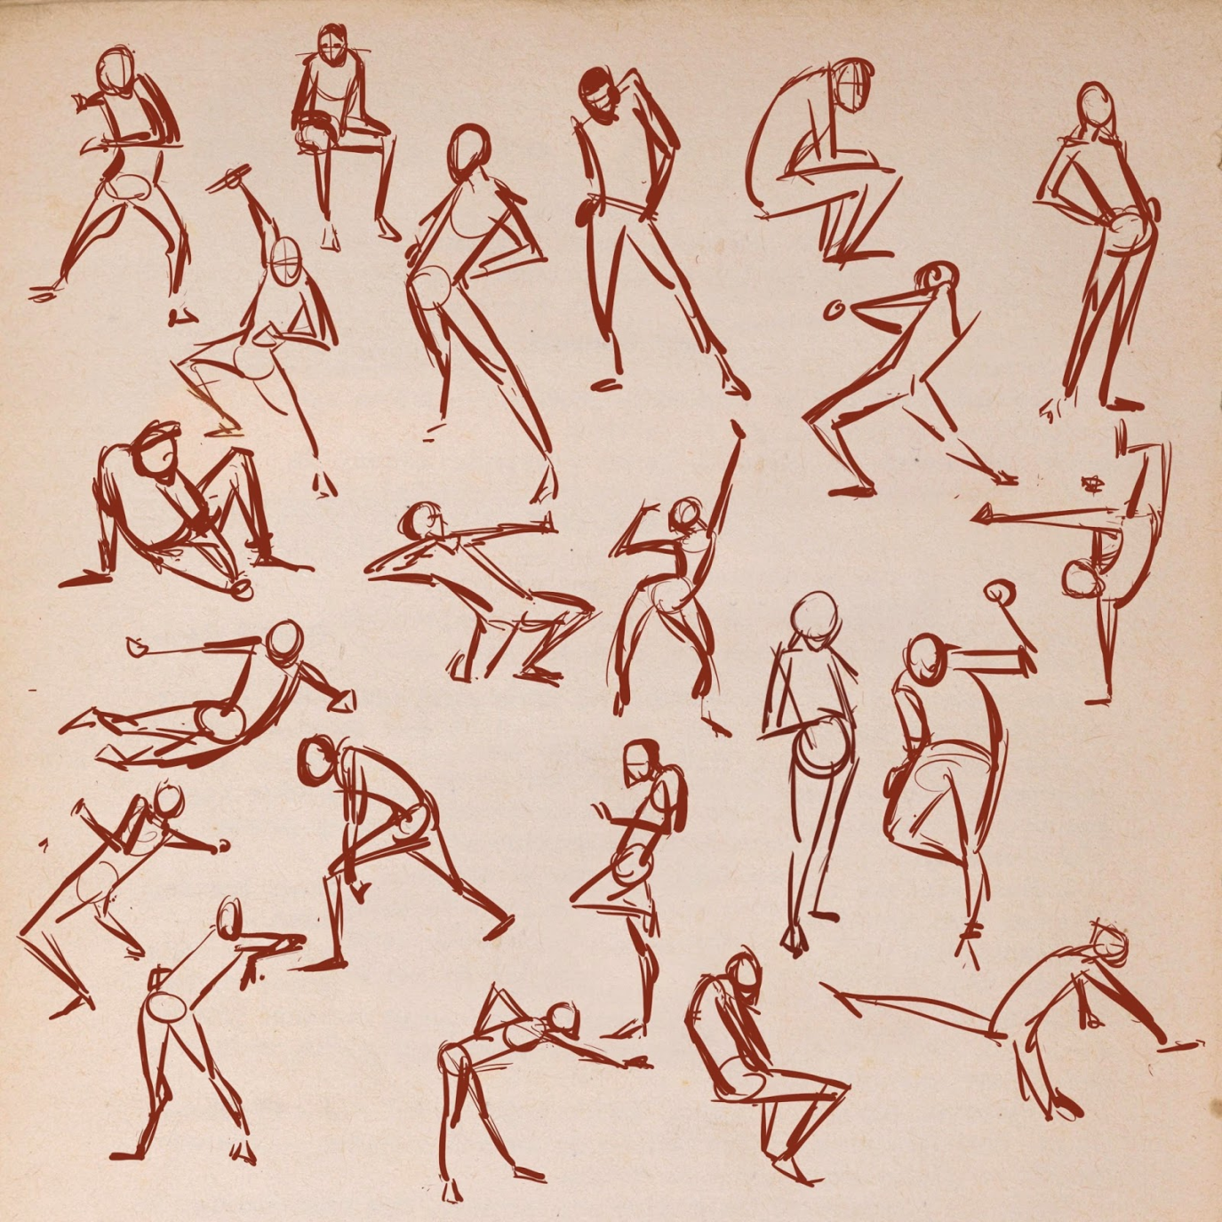
GESTURE DRAWINGS

Slide 12
A gesture drawing is a human figure in motion. Do 15 drawings. Stick figures-no detail please! Number and label each with the action it’s performing.

Slide 13
Watch this video to see how to create a wire human figure:
https://www.youtube.com/watch?v=mKFQwqe-85o
Start it at 20 seconds
End it at 9 minutes 10 seconds

