Slide 1
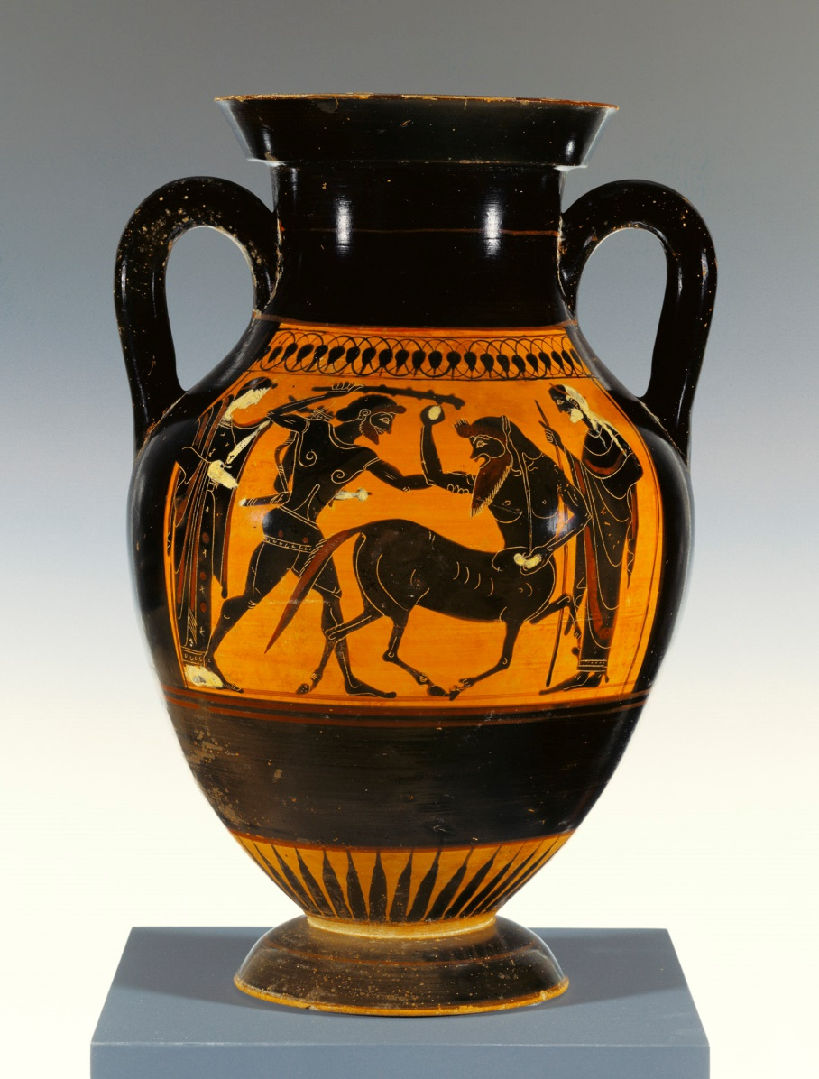
Greek Vessels

Slide 2
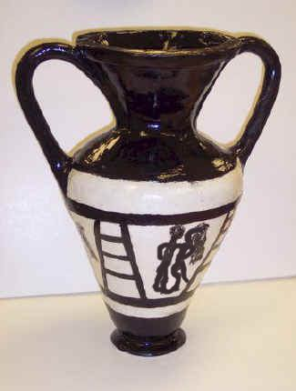
Student Example-What do you see?

Slide 3
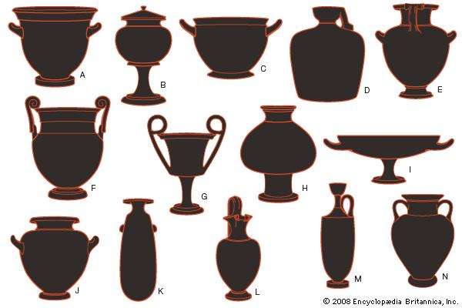
Variety of shapes and uses:

Slide 4
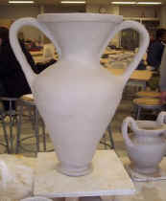
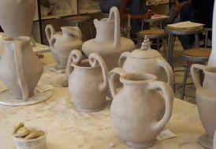
In progress work…

Slide 5
Use a template!

Slide 6
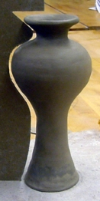
Shrinkage will occur…

Slide 7
Process:
Cut slab circle for base (about 1/4"thick).
Shape vessel with wide slabs. Roll out slab of clay about ½" thick - cut into 1 inch strips. taper ends to overlap. Score and slip. This method was quicker than rolling out coils. But, you may choose what works best for you.
Control shape using cardboard template.
Scrape with metal scrapers to smooth surface. Smooth with sponges, just don’t use too much water or it will slump.

Slide 8
Handle and Design:
Handles need to be added when clay is leather hard.
We will do an in class demo on how to
“Pull a Handle”
Greek designs often tell a story
Your design does not need to tell a story, but can. You choose.
The design needs to wrap around your vessel.

