Slide 1
Harvest Still Life

Slide 2
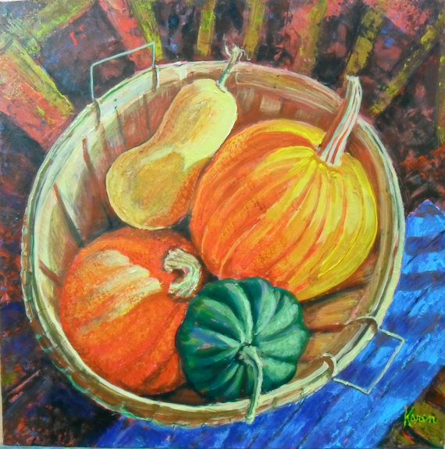

Slide 3
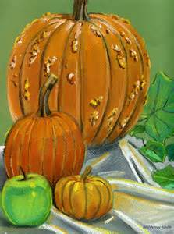

Slide 4
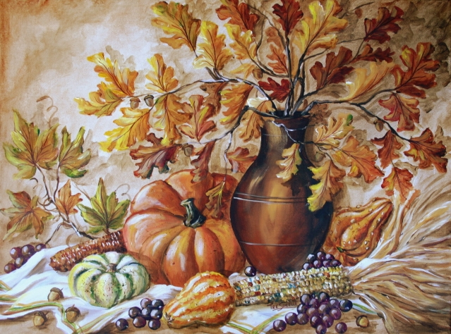

Slide 5
Begin by Sketching

Slide 6
When sketching, use LIGHT pencil pressure. You can use multiple pencil lines to get just the right angle, curve, etc.
CENTER your design. It’s ok if items “go off the page”.
Look for BASIC SHAPES like circles, triangles and rectangles.

Slide 7
Think about PROPORTION of the items.
Think about LOCATION of the items in relation to one another.
After you have drawn the items, identify the LIGHT SOURCE and it’s DIRECTION. This will help you start to think about highlights and shadows.

Slide 8
Continue by Adding Color

Slide 9
Start by adding BASIC COLORS.
Continue by BLENDING colors to create HIGHLIGHTS and SHADOWS.
Don’t forget to add DETAIL like TEXTURE to make it look more realistic.

Slide 10
Let’s practice!
Today: your goal is to sketch and color a gourd.
Keep in mind all that we covered.
Don’t be afraid to experiment!

