Slide 1
Holiday Ornament

Slide 2
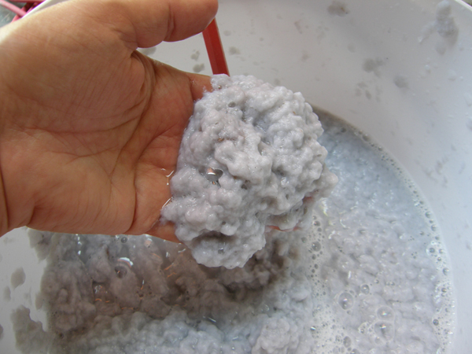
Mix paper pulp and water in a bowl. It should be consistency of oatmeal.

Slide 3
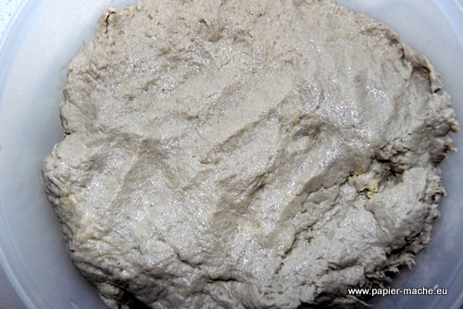
Squeeze out excess water.

Slide 4
Work on a board covered with plastic so your project doesn’t stick.
You can use a cookie cutter mold.
Or you can hand sculpt your design.
Make sure you press your paper pulp design so it sticks together.

Slide 5
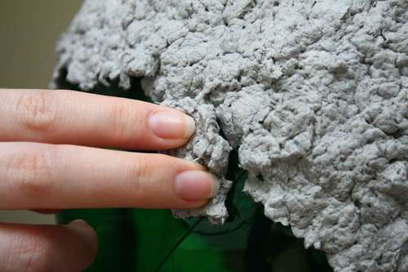
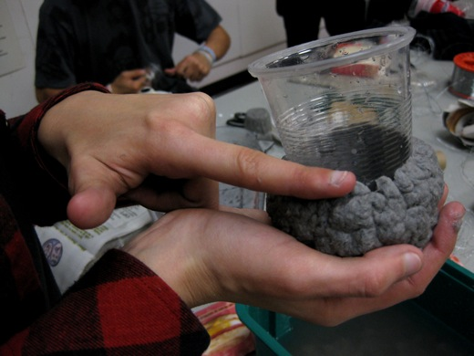
You can use a mold.

Slide 6
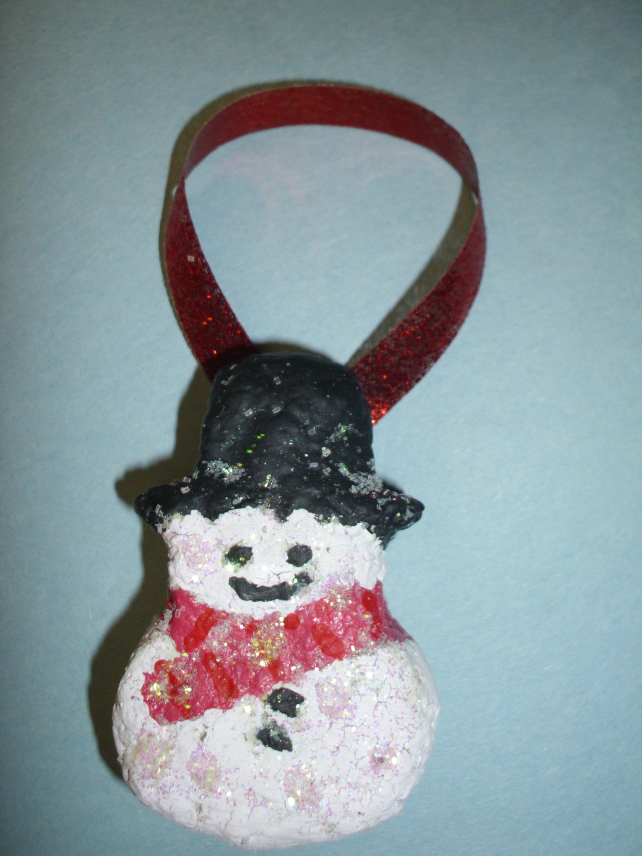

Slide 7
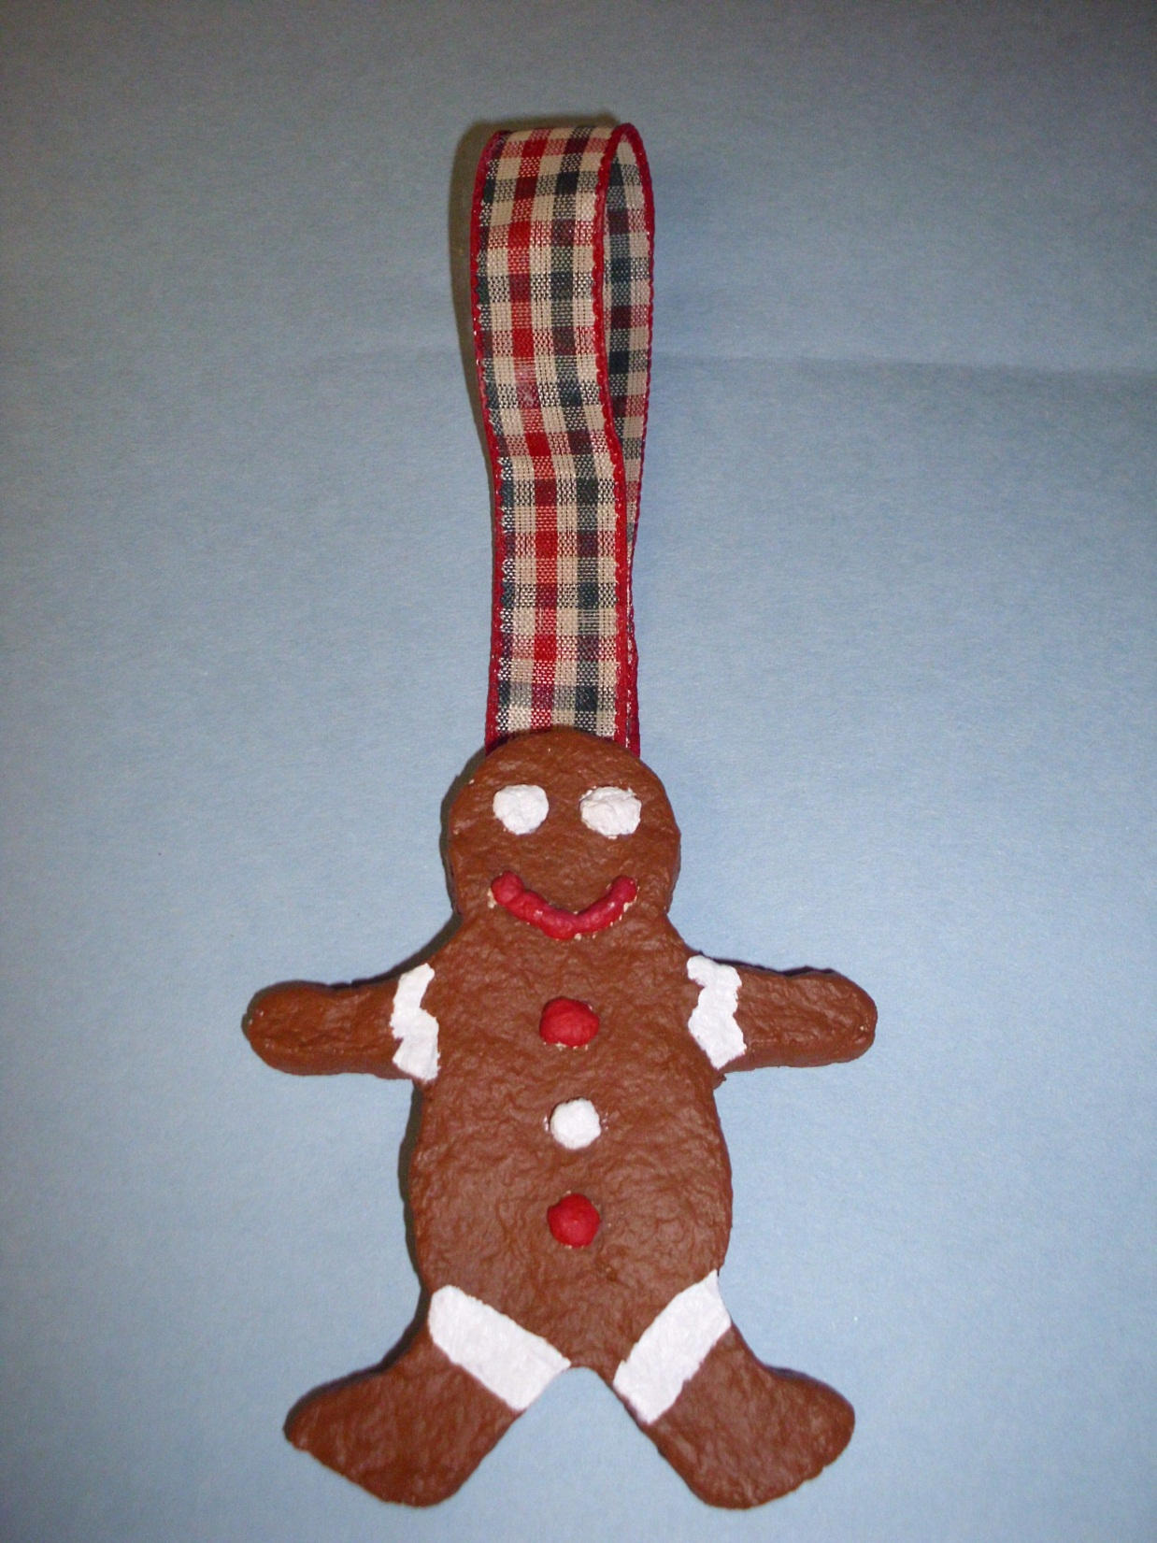

Slide 8
Or make your own design…

Slide 9
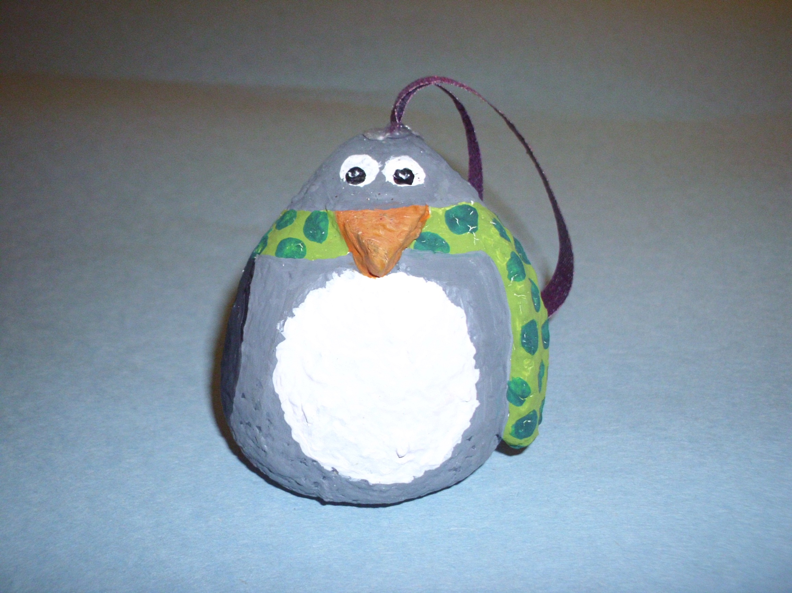

Slide 10
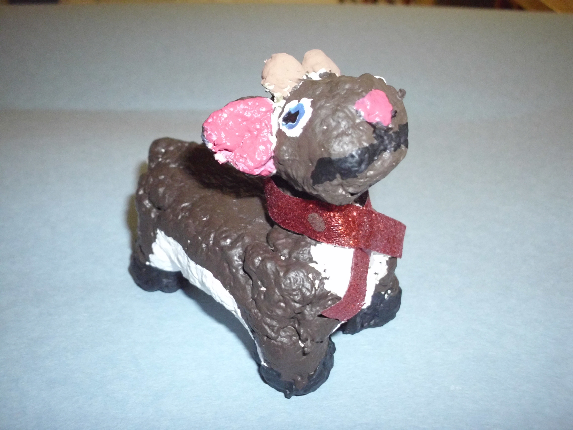

Slide 11
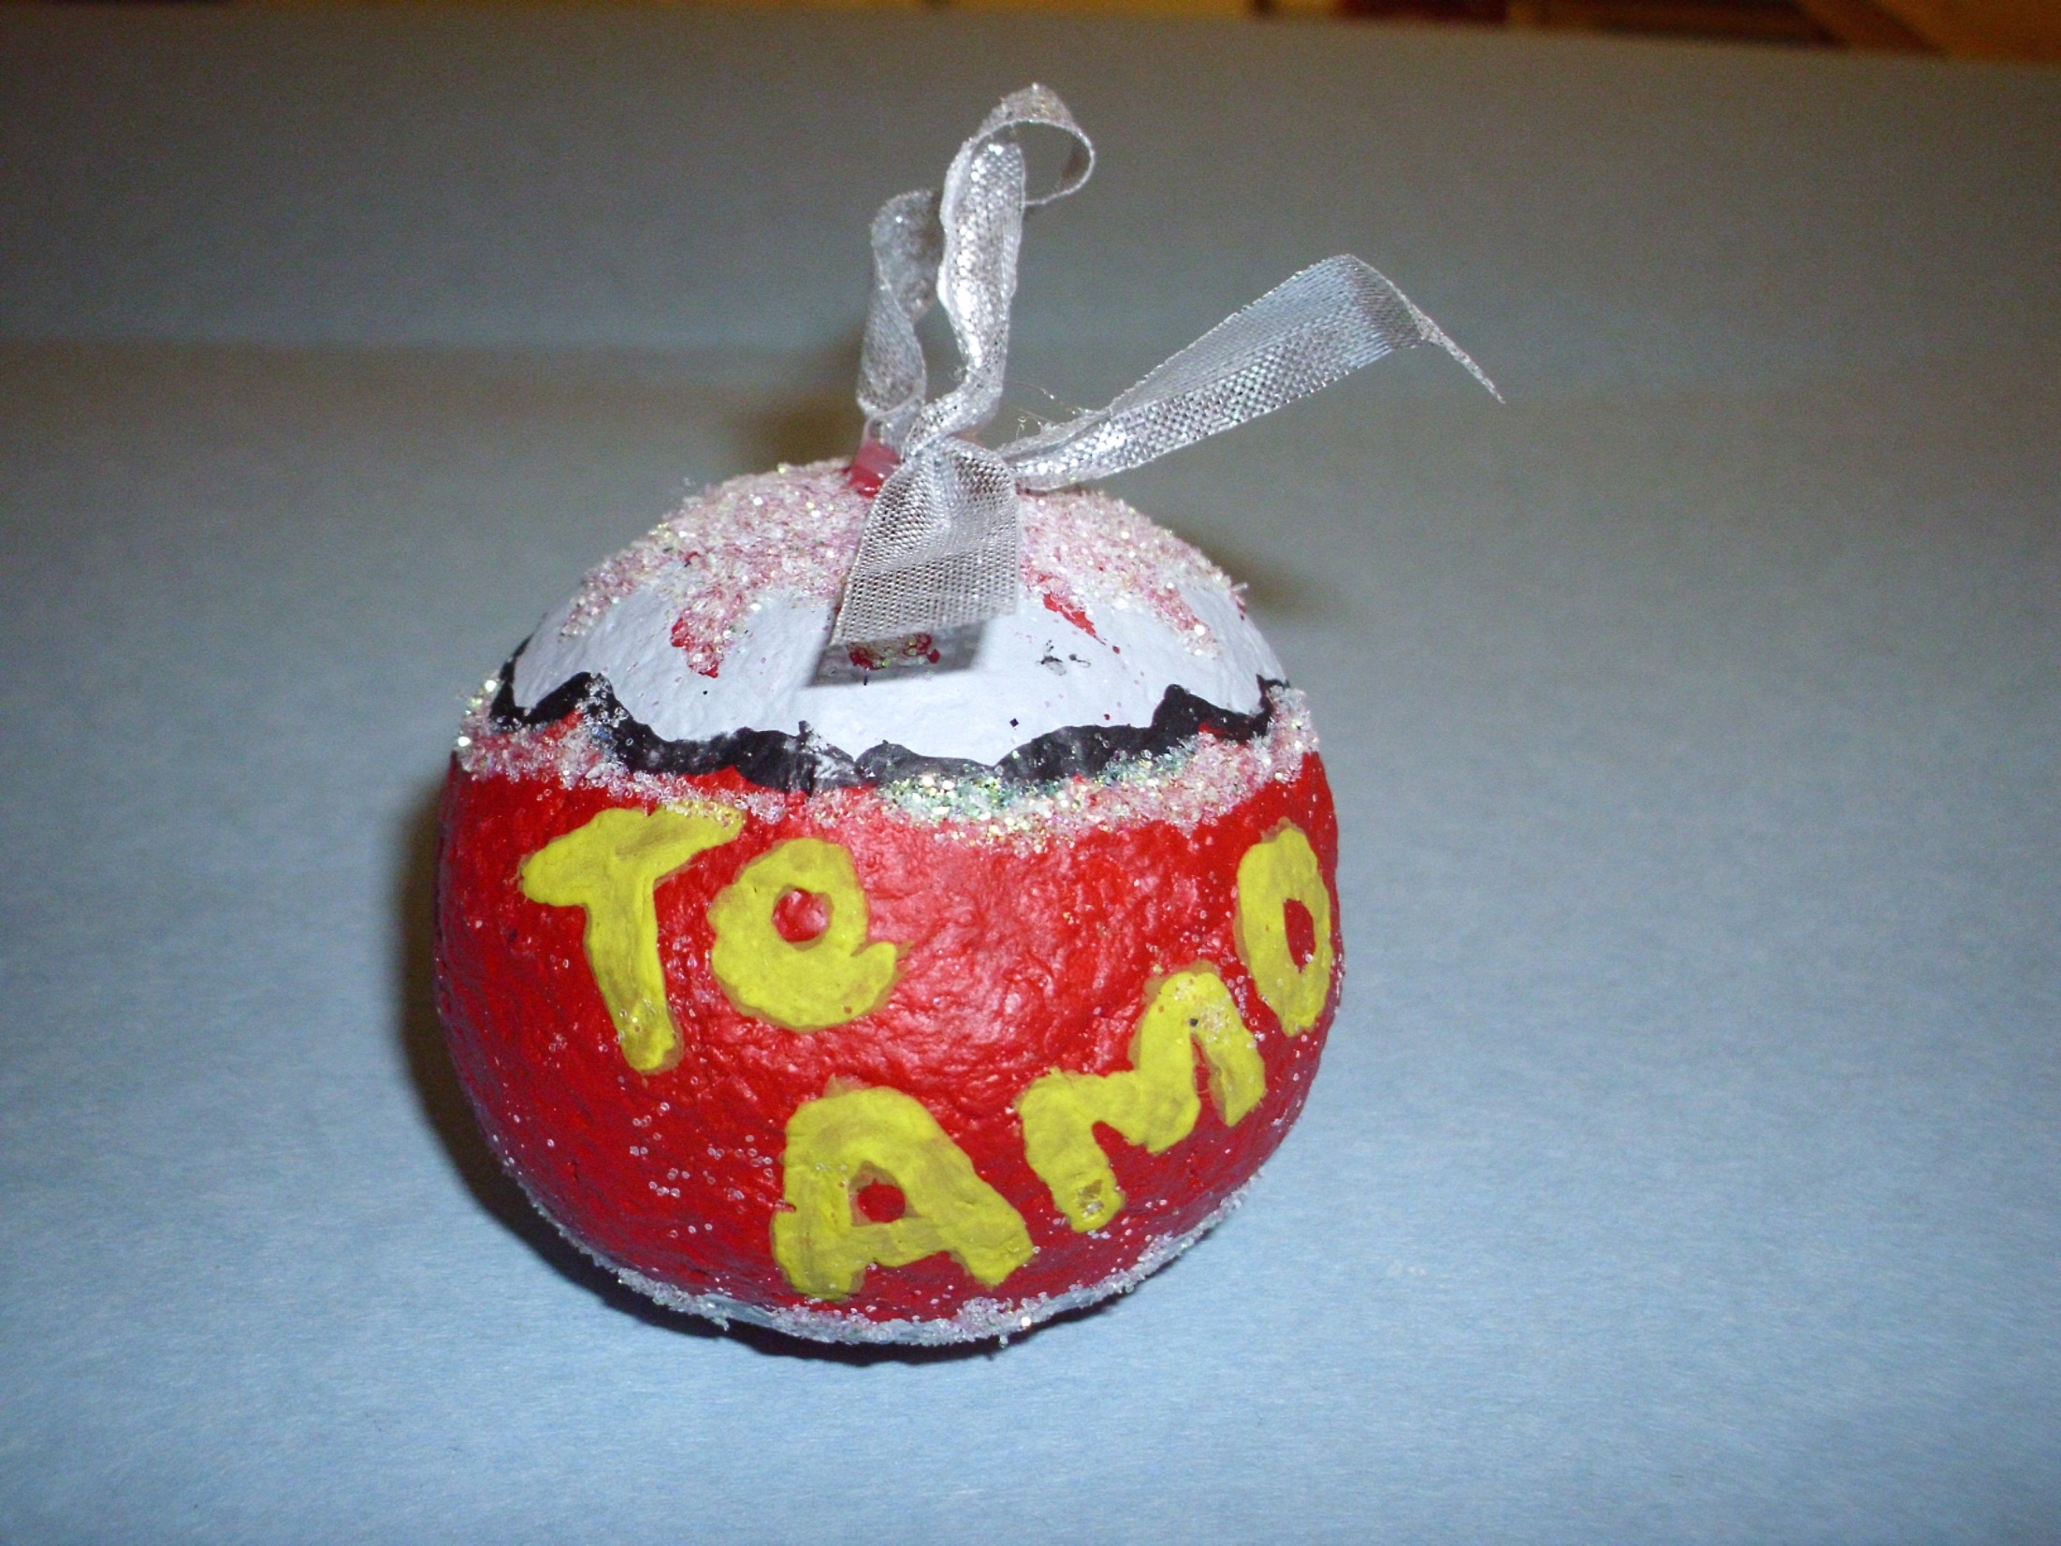

Slide 12
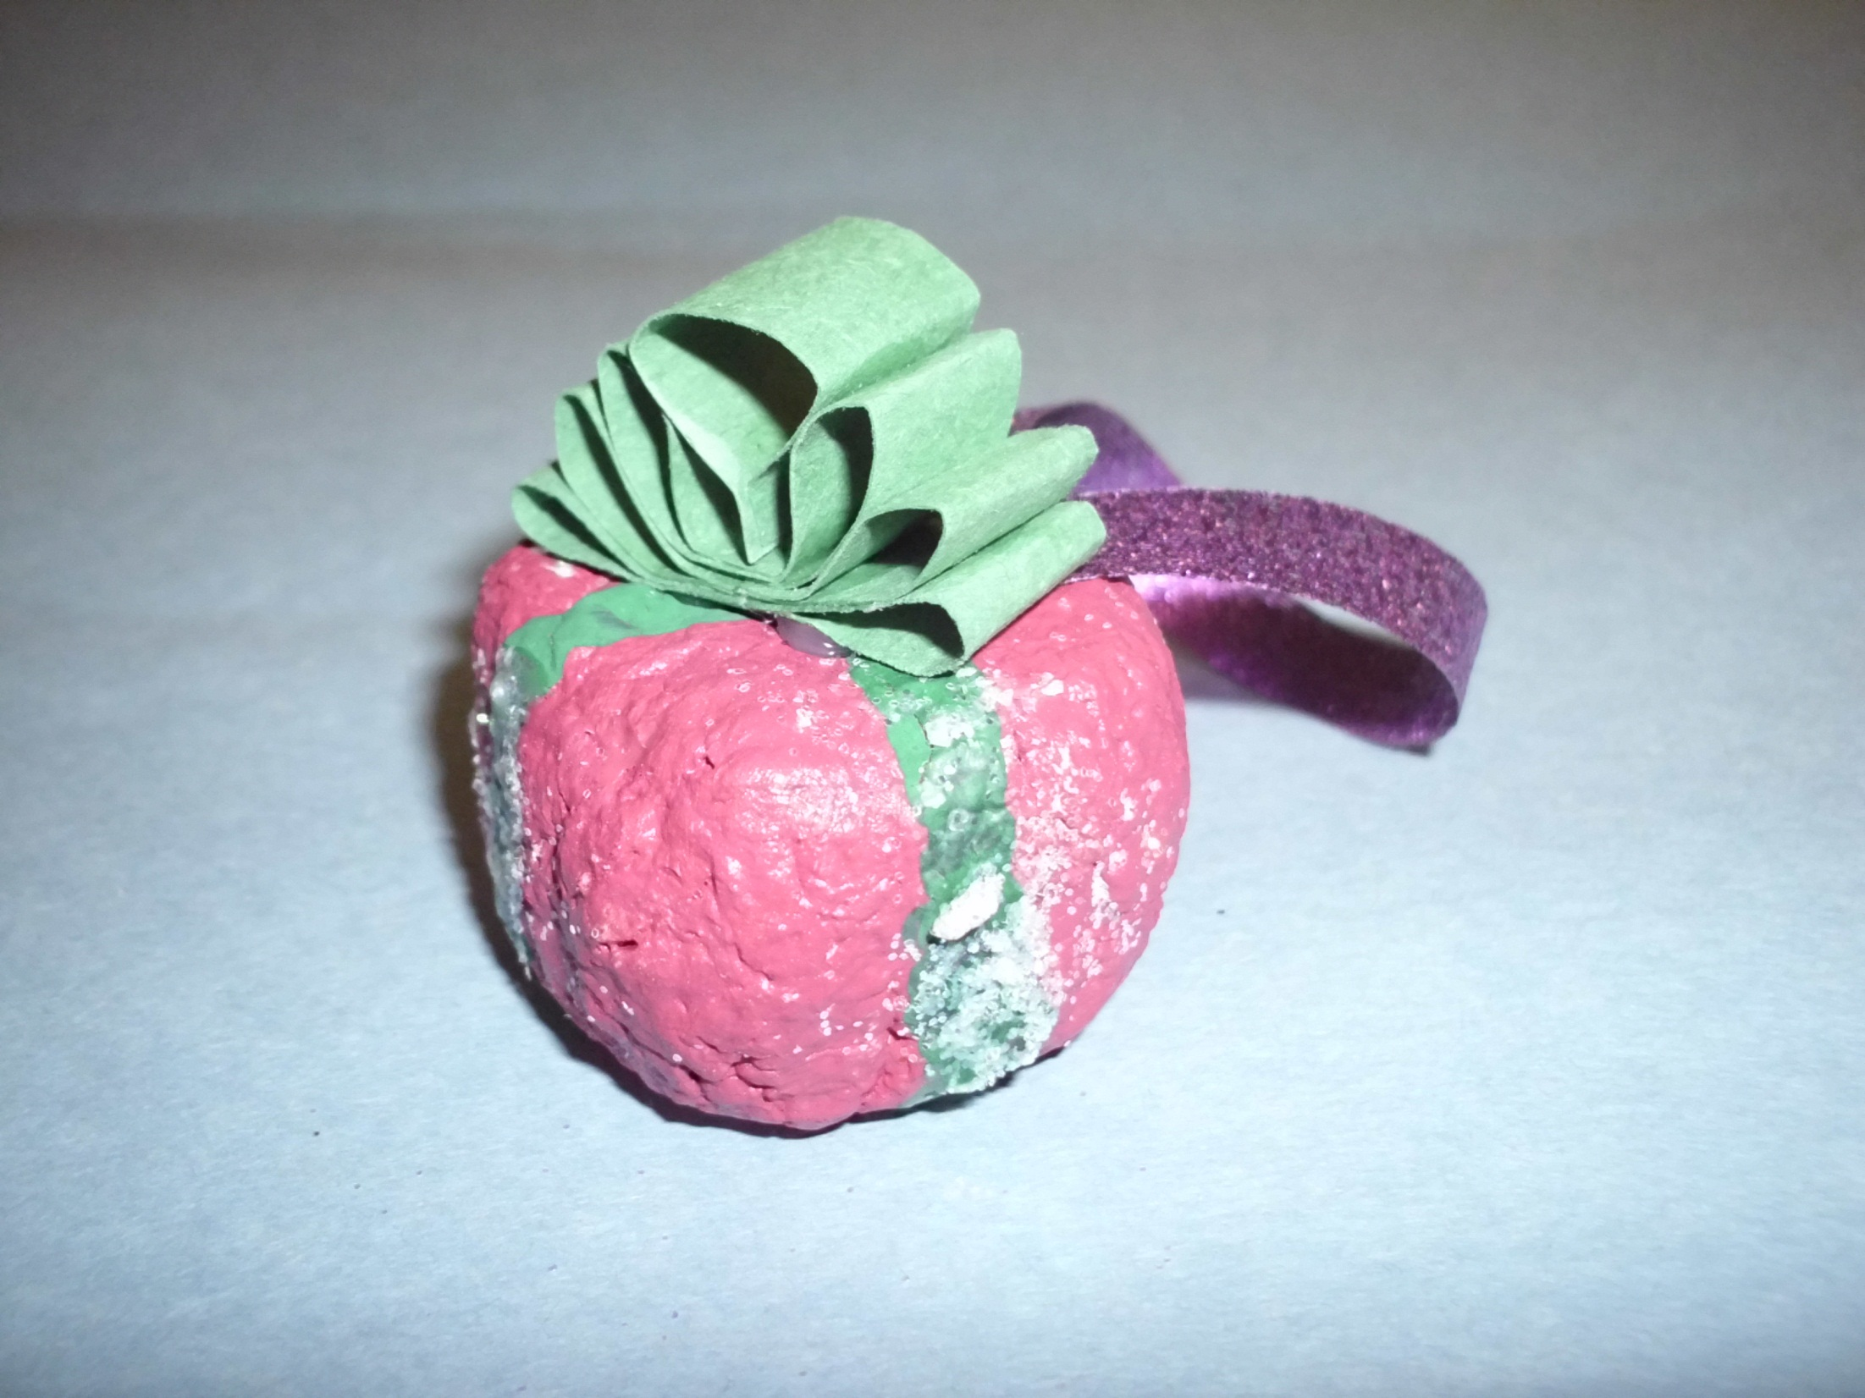

Slide 13
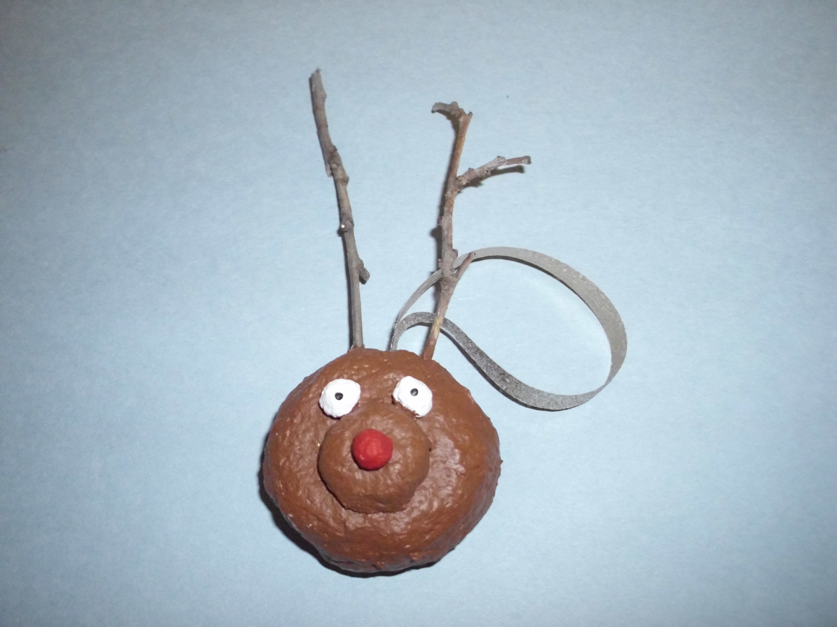

Slide 14
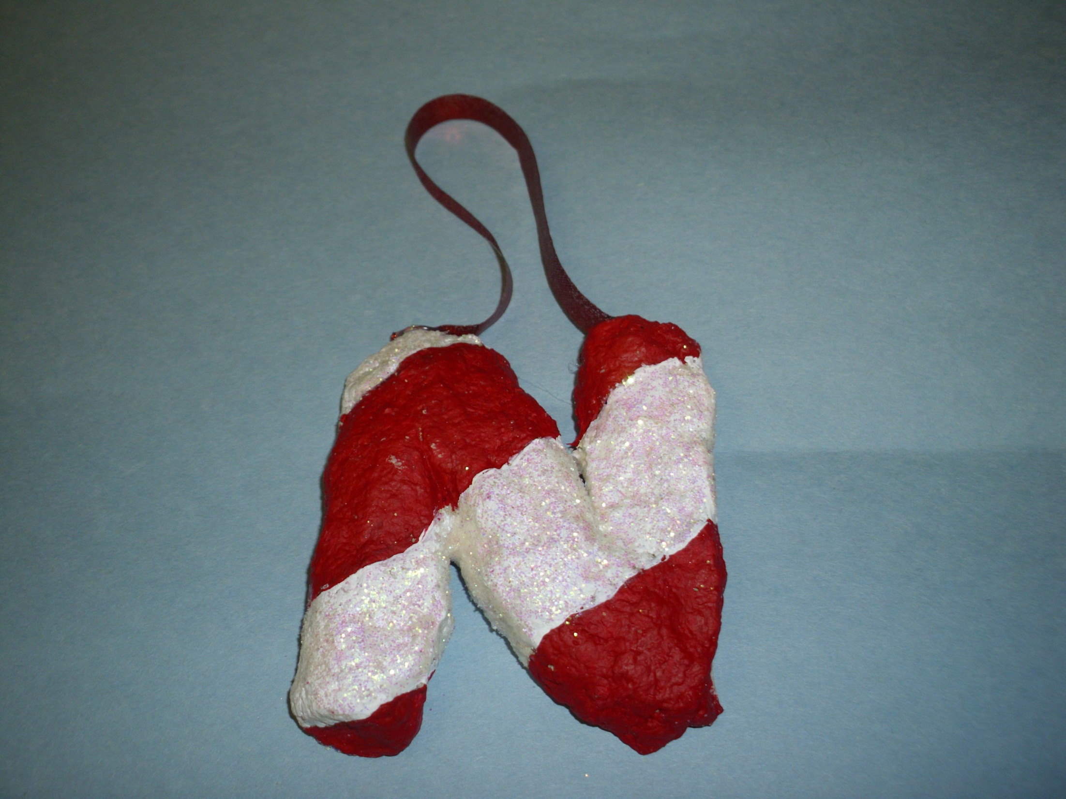

Slide 15
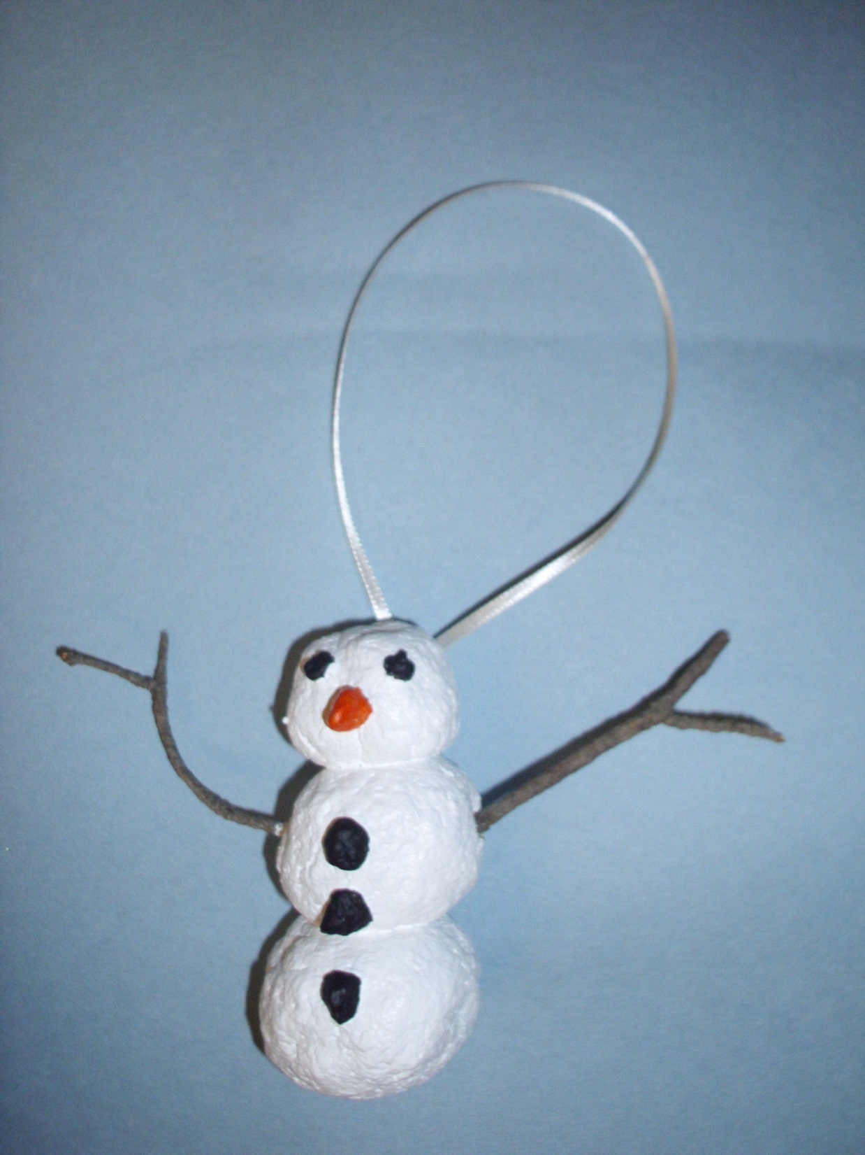

Slide 16
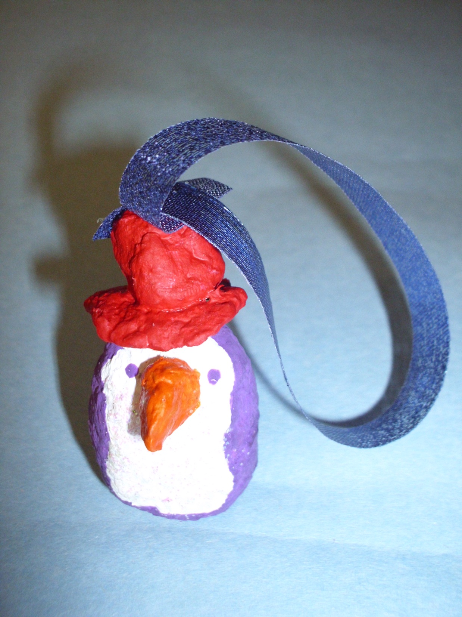

Slide 17
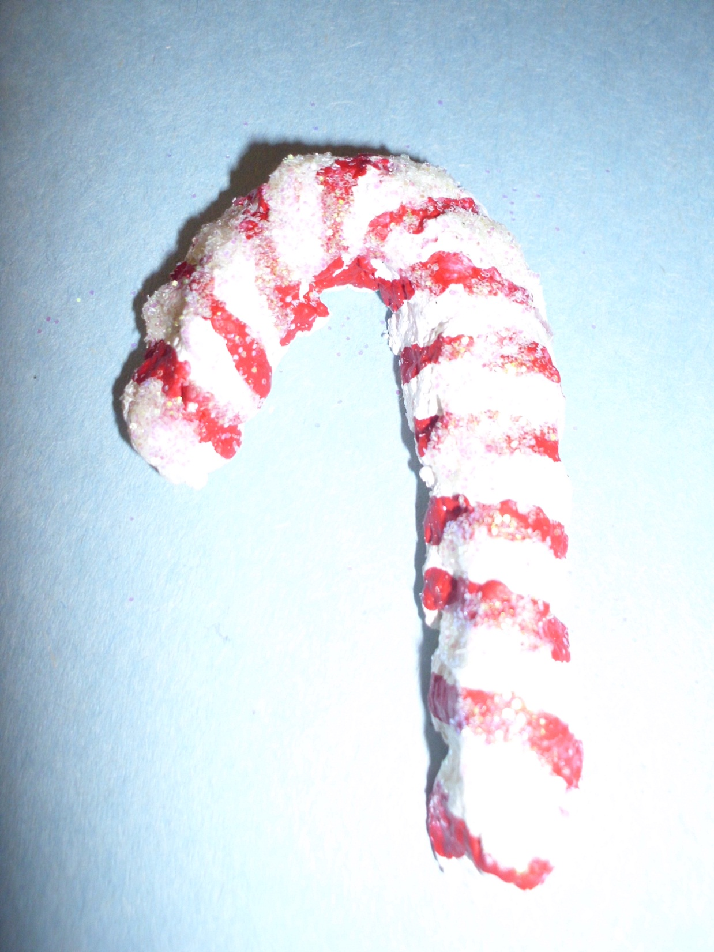

Slide 18
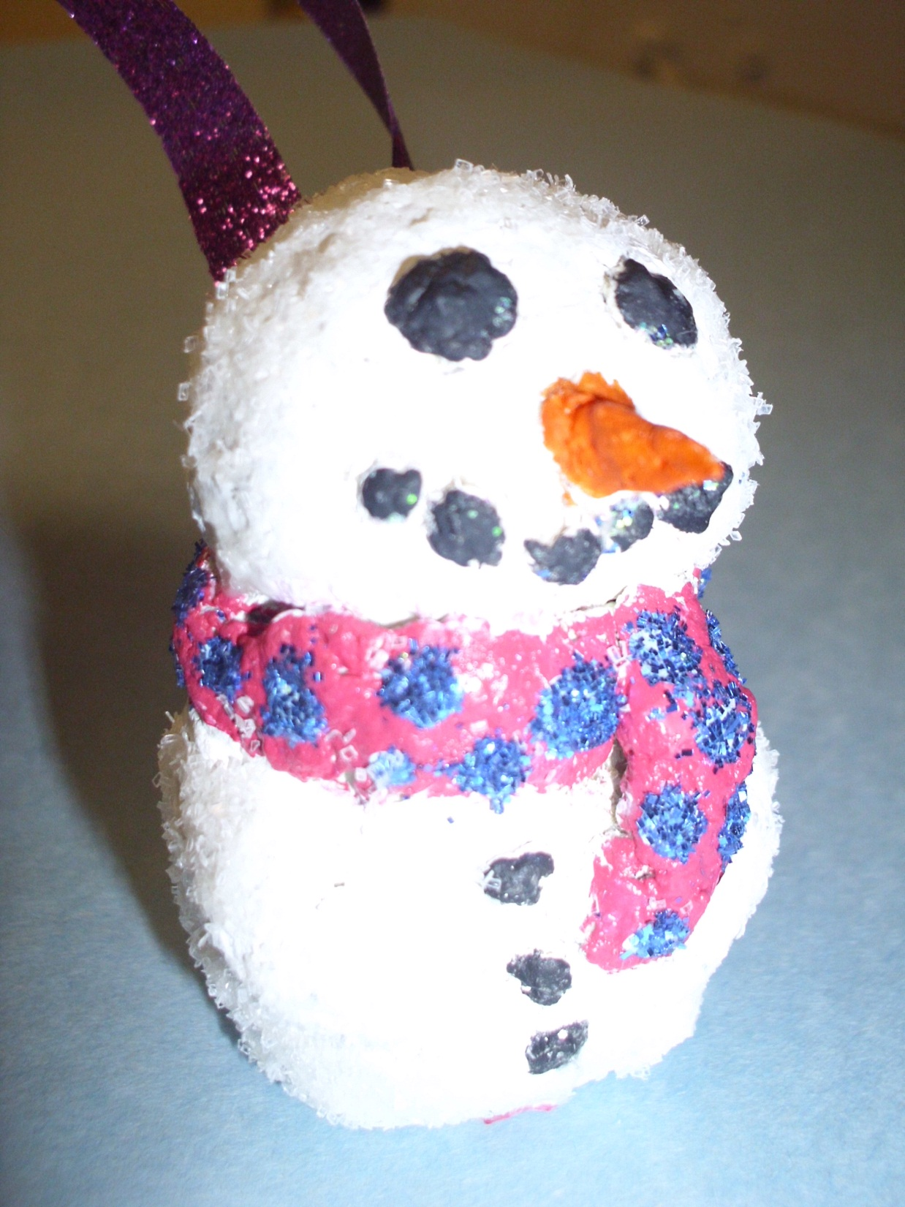

Slide 19
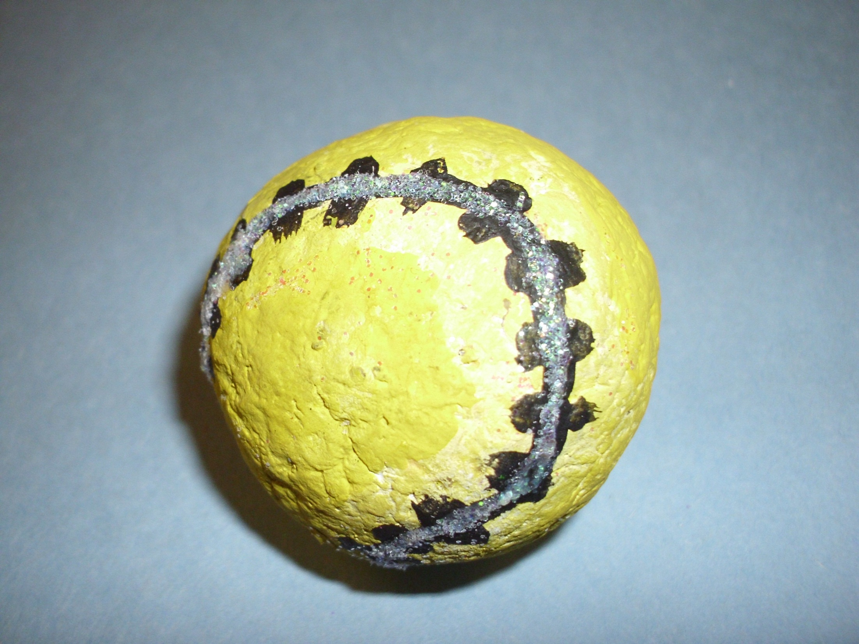

Slide 20
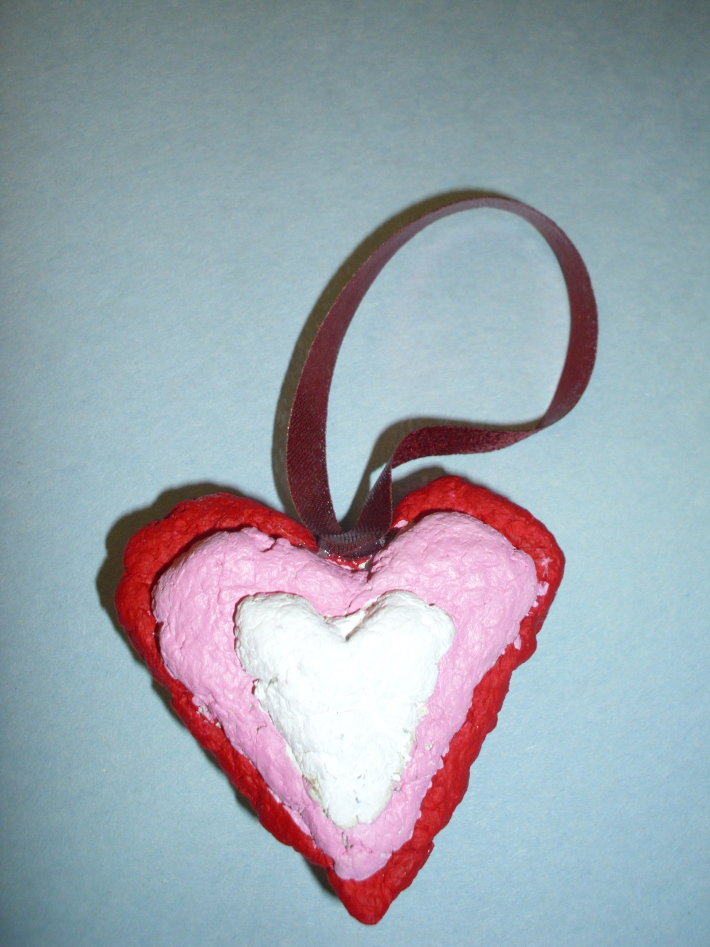

Slide 21
Finishing Touches
These will take a long time to dry.
When they are finally dry, we will paint them and glue a ribbon on them for display.

