Slide 1
How To Delete a Background in Photoshop
By: Grant Nolan

Slide 2
Starting a Project
1) Open Adobe Photoshop CS3 .
2) Choose “File” > “New”
3) Title is your last name and Photoshop Background. Change to 8 x 10 inches.
4) Change the “Resolution” to 300 pixels/inch
5) Select “OK”
6) Choose “File” > “Place”
7) Press the “Enter” key on your keyboard

Slide 3
2. Making it an image
When you first open an Image its opened as a background, what you’re gonna wanna do is go over to your layers and right click on Background. After you do that, select the layer from background.

Slide 4
3. Selecting your background
All three do different things like the quick selection tool, selects a lot really fast but doesn’t know exactly what to select. The lasso tool is more precise.
These are the 3 tools (top:Lasso, Middle:Quick Selection, Bottom: Eraser)

Slide 5
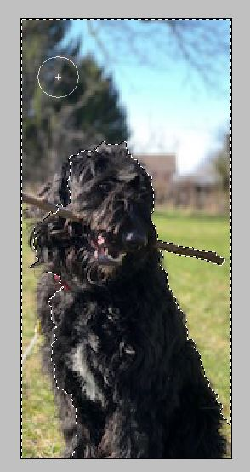
4. Quick Selection
The Quick Selection Tool(Hotkey= W) is very useful but may have problems like this, look at the dogs ear it has half of it selected and you may not want that for your photo. If it keeps doing this to you it’s not the tool you want.

Slide 6
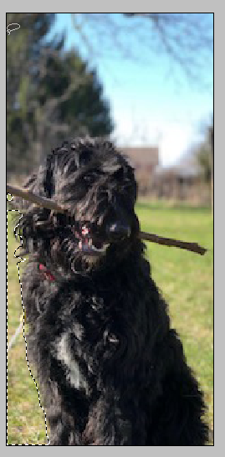
5. Lasso Tool
The Lasso Tool(Hotkey= L ) it is very precise but you have to work in smaller segments which isn’t always the worst, here is an example of the lasso you see it by the bottom left corner the line is more where you want it and not so over the dog.

Slide 7
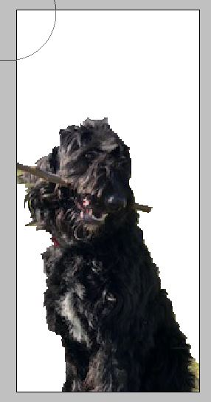
6. Erasing the background
There are 2 ways to delete the background. The Eraser Tool(Hotkey= E) which can be fast depending on the size of the tool which can be altered with Left Bracket {=Smaller, Right Bracket }=Larger
Or just using the Delete Key on the Right Middle of the keyboard which is very fast and easy to use.

