Slide 1
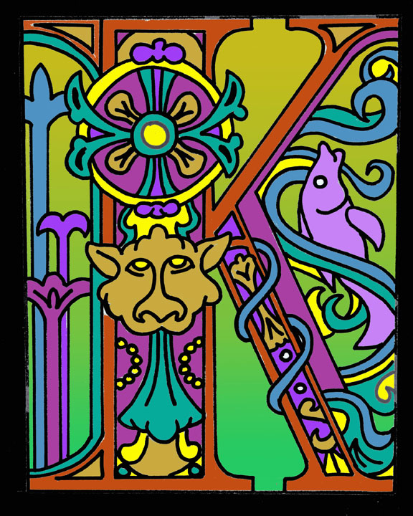
ILLUMINATED LETTER

Slide 2
FOR THE NEXT WEEK, YOU WILL BE AN ILLUMINATOR:
ILLUMINATION:
in art, decoration of manuscripts and books with colored, gilded pictures, often referred to as miniatures (as in miniature paintings); historiated and decorated initials; and ornamental border designs.

Slide 3
HISTORY:
During the middle ages, clerics and scribes would work tirelessly on pages of manuscripts for the church and for kings. While they translated the Bible they would decorate or illuminate the first letter in a paragraph. This miniature painting was one of the middle ages, or Gothic time period’s, best art.

Slide 4
STARTING YOUR ILLUMINATED LETTER:
CHOOSE A LETTER THAT HAS MEANING TO YOU SUCH AS AN INITIAL.
CHOOSE A FONT FOR THAT LETTER.
CHOOSE IMAGES THAT GO WITH THE MEANING OF THE LETTER SUCH AS INTERESTS, HOBBIES, SPORTS, ETC.
CHOOSE A DESIGN STYLE SUCH AS ART DECO.
MAKE SURE ALL YOUR ELEMENTS WORK WELL TOGETHER.

Slide 5
STYLIZED IMAGES:
The mode of design called stylization means to simplify things to their most basic components. Cartoons are stylized and simplified versions of real things. Sometimes when we stylize we can use less detail to show the same thing.
For instance, if you were stylizing a bird and the feathers in the wing, you would simplify the number of feathers to a smaller number in order to see that it is a wing but not have to show every feather.

Slide 6
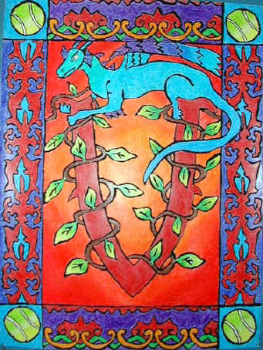
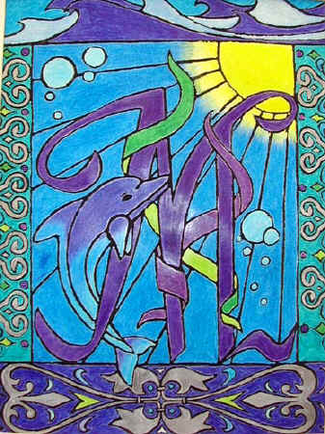
STUDENT EXAMPLES:

Slide 7
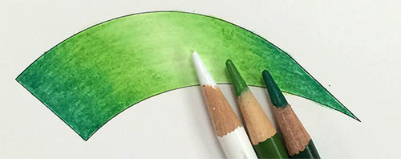
Blending Colored Pencils
 | Pick a dominant color - in this case it's medium green. Prepare at least 3 pencils: WHITE, MEDIUM GREEN, and DARK GREEN. If you chose a different dominant color - use the formula:
White + Dominant color + Darker version of the main color

Slide 8
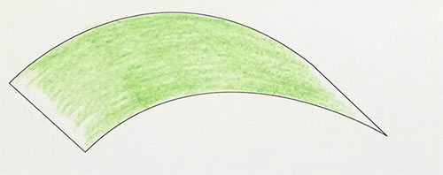
Step 1
 | Start with a Medium Green. Shade lightly most of the surface. *Direction of coloring matters! Choose a direction and stick with it. Turn your paper if it feels awkward.

Slide 9
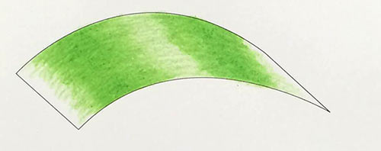
Step 2
 | Go over with the same Medium Green pencil and color more intensely, leaving the middle as is.

Slide 10
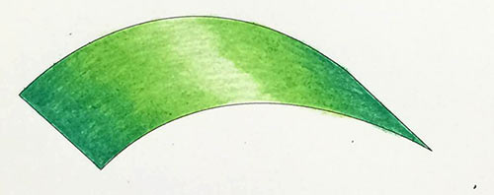
Step 3
 | Use Dark Green and color in the sides of the shape, use Medium Green again to blend the two colors. Always use the lighter colors of the two for blending.

Slide 11
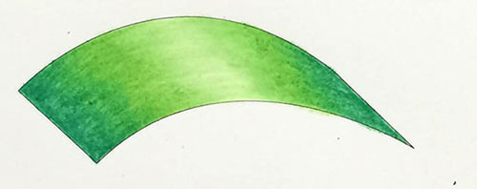
Step 4
 | Use White pencil to blend the middle part - the lightest area.

Slide 12
WATERCOLOR PENCIL TECHNIQUES:
DRY ON WET: wet your paper and draw with a dry watercolor pencil.
WET ON DRY: dip your watercolor pencil in water and draw with it on dry paper.
DRY ON DRY: color using a dry watercolor pencil. Then, use a wet paintbrush to blend.

Slide 13
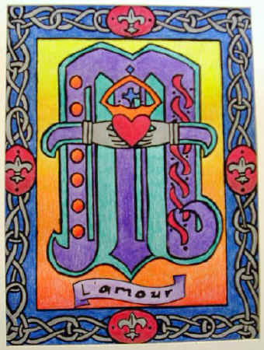
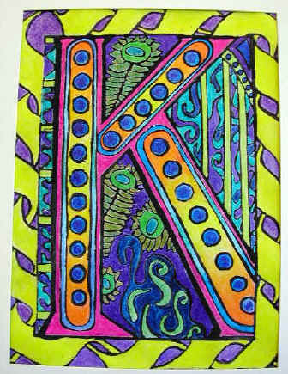

Slide 14
PUTTING IT ALL TOGETHER:
DRAW YOUR BORDER AROUND THE EDGE OF YOUR PAPER.
DRAW YOUR LETTER USING THE FONT YOU CHOSE IN THE CENTER OF YOUR PAPER.
DRAW YOUR STYLIZED IMAGES AROUND YOUR LETTER AND/OR BORDER.
DRAW YOUR CHOSEN DESIGNS AROUND YOUR LETTER, BORDER AND STYLIZED IMAGES.
ADD YOUR COLOR USING COLORED PENCILS AND/OR WATERCOLOR PENCILS. BE SURE TO BLEND YOUR COLORS AND CREATE A GRADIENT.

