Slide 1
Sgraffito Plate
Slab Build slump Mold and SGraffito Technique Using a Radial Design Plate

Slide 2
Create Radial Design on paper.
Make Clay Piece.
Dry to Leather Hard.
Brush on CONTRASTING underglaze, engobe, or slip.
Transfer design onto clay piece.
Sgraffito
Add a Foot Ring
SLOWLY DRY
Bisque fire
Paint with clear gloss glaze (cone 05)
Glaze Fire

Slide 3
Equipment and Tools for Making Plate
Large rolling pin or slab roller
Canvas or fabric to keep slab from sticking to table while rolling it out
Cut off wire (if you are cutting your clay off of a prepared brick of clay)
Sponge
Clay (choose a clay body that will contrast with the underglaze, slip, or engobe you are using)
Fettling knife or needle tool (to cut out slab)
Paper plate that DOES NOT have a plastic coating so that the plate can absorb moisture from your clay.

Slide 4
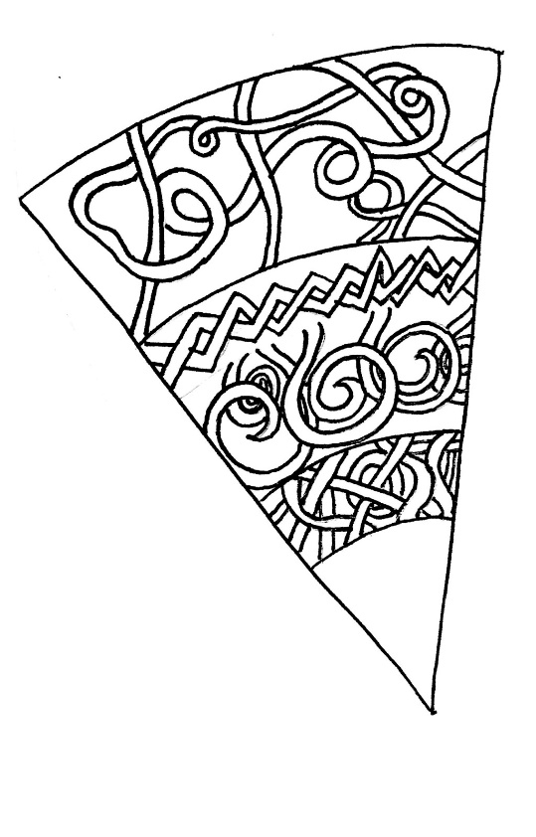
1. Create Radial Design
Create a radial design by using the template provided OR create your own
HOW TO CREATE YOUR OWN TEMPLATE:
Circle diameter between 7 to 8 inches
Determine the number of sections you want (need at least 3)
Divide number of sections by 360* to determine angle of each section.
The template above has 12 equal sections. Determined by the equation 360/x=y
X= total number of desired sections
Y= degree of angle for each section.
Notes:
This step does not have to be done first. It’s recommended as the first step because some complicated designs can take a while to make. Students could work on their design while they wait for the plate to dry to leather hard while in the slump mold(paper plate)

Slide 5
2. Make the Clay Piece- Getting Started
ALL STUDENTS WILL BE MAKING A PLATE for this project
Roll out a slab to desired thickness LESS THAN ½ inch!
Slab must be big enough to cut 1 plate sized circle that will be 9 inches
When rolling out a slab, start by throwing it down and across the table in different directions until it is somewhere close to 3 (or less) inches thick.
Use slab roller or rolling pin and slab thickness strips to roll slab to the desired thickness.
Roll 2-3 times on one side, stop, flip AND turn quarter of a rotation and repeat until slab reaches desired thickness.
When you lift the slab do it carefully creating as much surface area with your hand as possible.
Use a rib tool to smooth and compress the slab BEFORE you cut out your shape.

Slide 6
How to Roll Out a Slab
https://www.youtube.com/watch?v=2oszILuetbQ

Slide 7
2. Make the Clay Piece- Cutting the Shape
Place the paper plate upside down to use as a template for cutting the slab (fig. 1)
As you cut keep the cutting tool perpendicular to your work surface to create a square rim.
Remove excess clay FIRST before trying to pick up/move the circle.
Fig.1 Using a paper plate as a template, cut a circle in the slab
Notes:
Student could make sets of plates!

Slide 8
2. Make the Clay Piece – Smooth the Lip (Edge)
Slide your finger across the lip (edge of the rim) with firm consistent pressure. (fig.2) The sharp corner of the rim softens without flattening the edge.
A damp sponge will also work instead of your finger.
Put your initials and class period on the underside.
Flip the clay slab, smooth the top edge
Fig.2 Remove excess clay from the rim

Slide 9
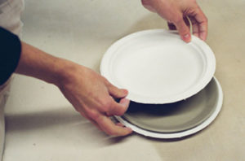
2. Making the Clay Piece- Forming Plates
Place circle slab into the paper plate, lining up the edges so it is centered (fig. 3)
Experiment with pressing the clay into the paper plate with your hands or sandwiching your clay between two plates (fig.4)
The clay will have a different character depending on your chosen method
Fig.3 Flip the slab over and place it in the plate
Fig.4 Press the clay with your hands or press with another plate.

Slide 10
3. Let Dry to Leather-Hard
Allow plate to dry to leather-hard stage in the bottom paper plate.
When your clay is leather hard: Remove the clay from the mold to check to see if it will sit on a flat surface without rocking
Take a moment to look closely at the lip of the plate to make sure it is smooth and rounded. If it is not then fix it with your finger or a damp sponge.
Notes:
Review strategies for controlling drying. If students choose to leave it out in open air it must be during class time when the can “watch” it. If allowing to dry between class periods the MUST bag it. I recommend students choosing an over sized bag for their plate or finding a bag that has small holes in it, poof out the bag so there is air in it and loosely closing the end so that there is a way for limited air to circulate.

Slide 11
Notes:
Review strategies for controlling drying. If students choose to leave it out in open air it must be during class time when the can “watch” it. If allowing to dry between class periods the MUST bag it. I recommend students choosing an over sized bag for their plate or finding a bag that has small holes in it, poof out the bag so there is air in it and loosely closing the end so that there is a way for limited air to circulate.
How to keep things leather hard between classes? – add damp newsprint or paper towel or fabric. BE CAREFUL if you have cheap thin paper towels as they tend to disintegrate which is why I prefer newsprint misted to damp with a spray bottle. DO NOT GET THE PAPER OVERLY WET or the clay will revert back to/stay in plastic stage.

Slide 12
4. Brush on Underglaze, Engobe, or Slip
Choose a CONTRASTING color.
If you chose a light clay, pick a dark or bright color.
If you chose the red clay chose a light color.
Brush on the first coat over the entire top side of your plate.
Wait for the first layer to dry to leather hard
Brush on the second coat
KEEP YOUR PLATE IN THE LEATHER-HARD STAGE THE ENTIRE TIME YOU ARE WORKING ON YOUR SGRAFFITO DESIGN
You can switch steps 4 and 5 (i.e. do step 5 first then step 4) if you want.
Notes:
This step and step 5 can be switched. You can see in the image that this example has the design already transferred on onto it BEFORE the underglaze has been applied.

Slide 13
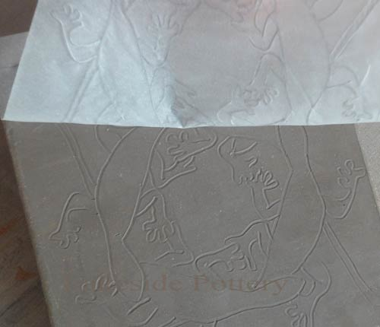
5. Transfer Design to Clay Piece
Place your design drawing on top of the plate.
Use a blunt pointed tool (such as a pen, pencil, modeling tool, etc) that will not cut through the paper. You are simply pressing the outlines into your plate.
Notes:
This step and step 4 can be switched.

Slide 14
6. Sgraffito
Use sgraffito tools to remove color where desired

Slide 16
7. Add a Foot Ring
After you have finished your sgraffito design.
While clay is still leather hard
Get a banding wheel (make sure it is clean) or place a piece of paper towel between plate and turn table top
Flip it upside down on the banding wheel
Roll a coil
Score, slip, smooth coil onto bottom.
When smoothing BE GENTLE so you don’t collapse your plate
If you covered your initials and class period with the foot ring then re-carve them in.

Slide 17
https://www.youtube.com/watch?v=YPsMxlc4vfw

Slide 18
8. SLOWLY DRY
After you have attached your foot ring allow your plate to dry slowly so the attachment can homogenize to (even out in moisture content) the plate. This ensures a secure attachment/
Slow dry by placing in a oversized bag and “poofing” it out so that there can be a lot of air in the bag. Close the bag LOOSLY leaving a small opening OR find a bag that has small holes in it already
Allow to homogenize for AT LEAST over night.
You should be able to take your piece out of bag the next class period AS LONG AS THE PLATE AND THE FOOT RING FEEL TO BE THE SAME STAGE OF CLAY.
Notes:
Whenever 2 pieces of clay that are in different stages (plastic coil attaching to leather hard plate) are attached allowing them to homogenize is really important. Things that are not allowed to homogenize are likely to fall of during drying or bisque firing.

Slide 19
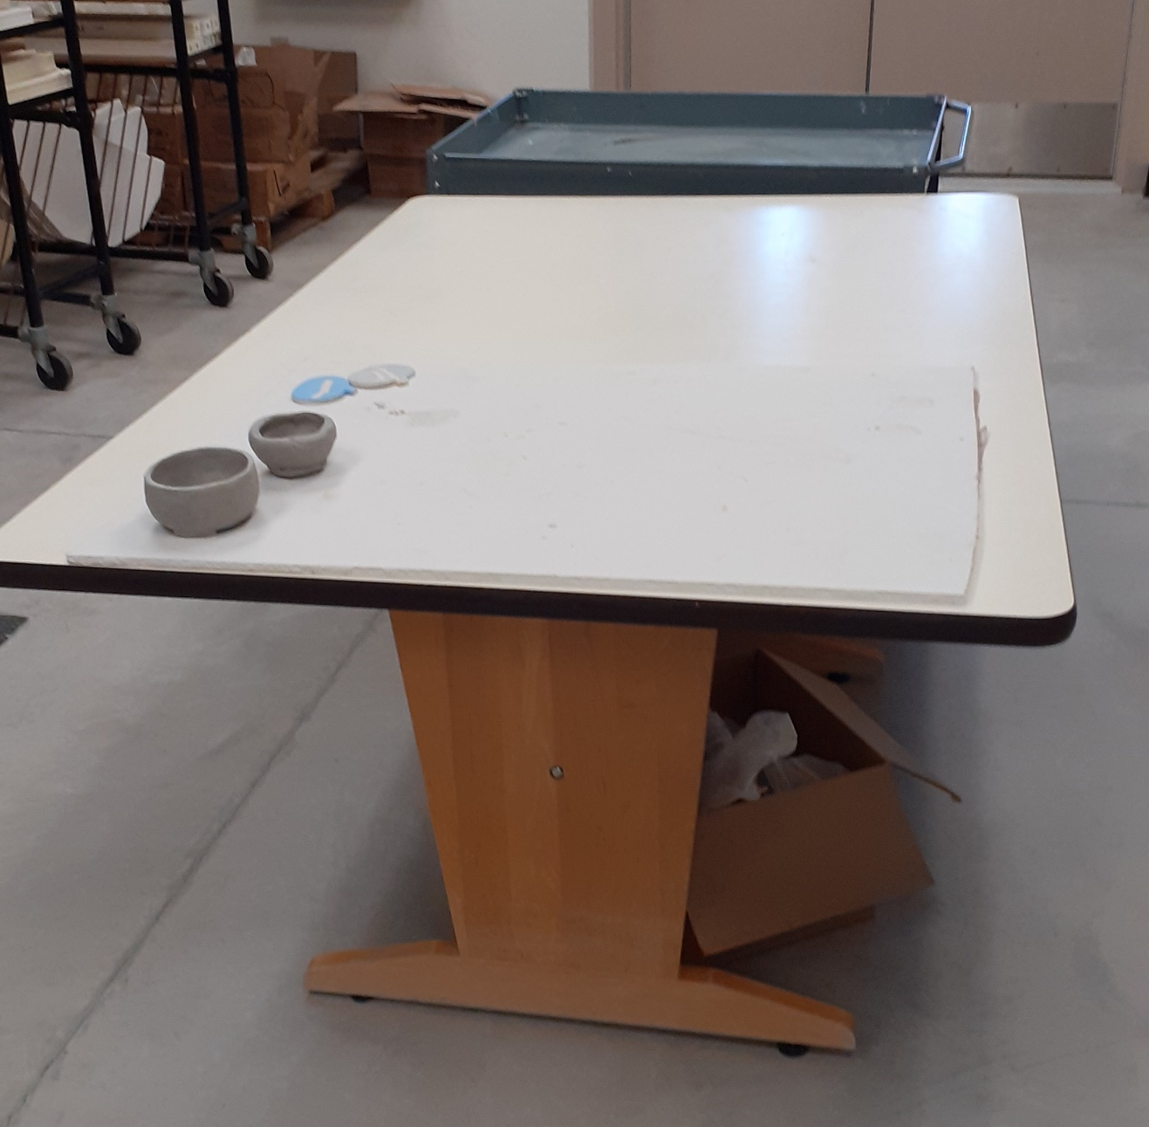
9. Bisque Fire
Place plate on center table in the kiln room after the foot ring has homogenized to finish drying
Once it is completely dry it will be bisque fired.
Notes:
This is my classroom set up. Delete or modify this slide to your liking.

Slide 20
10. Clear Glaze & 11. Glaze Fire
Brush on 3 Coats of Clear Cone 05 glaze.
DRY foot!!!
Place on correct side of counter for cone 05 glaze fire.
It will be fired as soon as there is a full Kiln Load Worth of projects
∆05
∆5
Notes:
11. Is again my set up…. Delete or modify as you desire.

Slide 26
Sgraffito Project Criteria – WRITE IT DOWN!!!
Followed ALL step by step instructions (from previous slides)
Sgraffito technique
Contrasting Underglaze, Engobe, or Slip applied correctly. Can do layered sgraffito just make sure you do it correctly too!
Detailed radial design using a variety of line types, widths, repetitions etc.
Slab slump molded plate
Good craftsmanship
Creative original idea
Foot ring on bottom (coil or slap strip attached after you have finished the sgraffito design)
Full coverage of clear gloss glaze with dry foot.

