Slide 1
Tiki using Slab and a Cylinder Mold

Slide 2
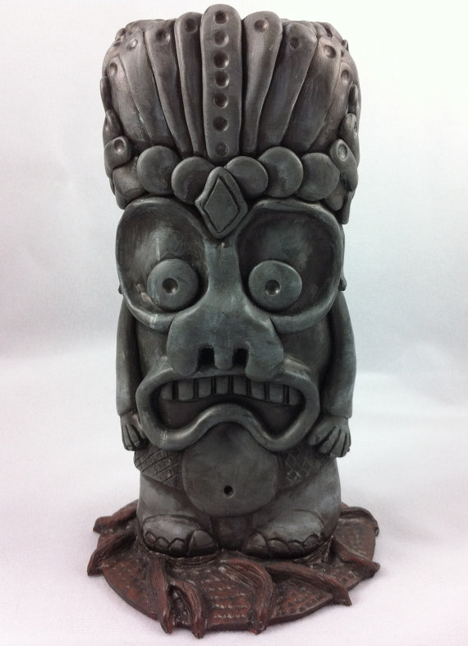

Slide 3
Process:
Roll a large slab of clay till it’s pinky width.
Use a cylinder as a mold and wrap your clay around it. Trim, score, slip and wiggle the ends together. Paddle and smooth over the seam.
Roll another slab pinky width. Stand up cylinder on it and trace a base. Cut, score, slip and wiggle to the bottom of your tiki.

Slide 4
Add Facial Detail:
Attach clay using the score, slip and wiggle method.
Carve away at clay. Be mindful not to carve too deep.
Impress your clay with tools to create pattern and texture.
Be sure to remove cracks and clay goobers.

Slide 5
Remove Cylinder Mold:
It’s important to remove the cylinder mold before your clay starts to dry.
If you don’t, your clay will shrink and crack because of the pressure from the mold.

