Slide 1
WORD
Portrait
Painting

Slide 2
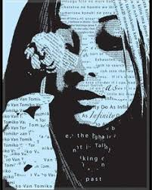

Slide 3
YOU HAVE 2 OPTIONS:
OPTION 1:
You will focus your project on YOU by creating a self-portrait.
OPTION 2:
You will focus your project on a HERO
IN OUR COMMUNITY. A hero is a person who goes above and beyond, who volunteers their time and energy outside of what is considered the norm, who has made a positive impact on you/our community (Greater Lansing Area). You will conduct an interview and take photo of the HERO for use with your artwork.

Slide 4
WORDS:
Words are singularly the most powerful force available to humanity. We can choose to use this force constructively with words of encouragement, or destructively using words of despair. Words have energy and power with the ability to help, to heal, to hinder, to hurt, to harm, to humiliate and to humble.
-Yehuda Berg

Slide 5
THEME:
Use a meaningful word or words for the background of the painting.
The words should marry well with the person in the portrait.

Slide 6
KINDS OF WORDS:
ONE WORD THAT DESCRIBES THE PERSON
POETRY YOU/THEY WRITE OR ENJOY
LYRICS YOU/THEY WRITE OR ENJOY
PROSE YOU/THEY WRITE OR ENJOY
SAYINGS YOU/THEY USE
QUOTES YOU/THEY CONNECT WITH
COLLOQUIALISMS YOU/THEY USE
ETC…

Slide 7
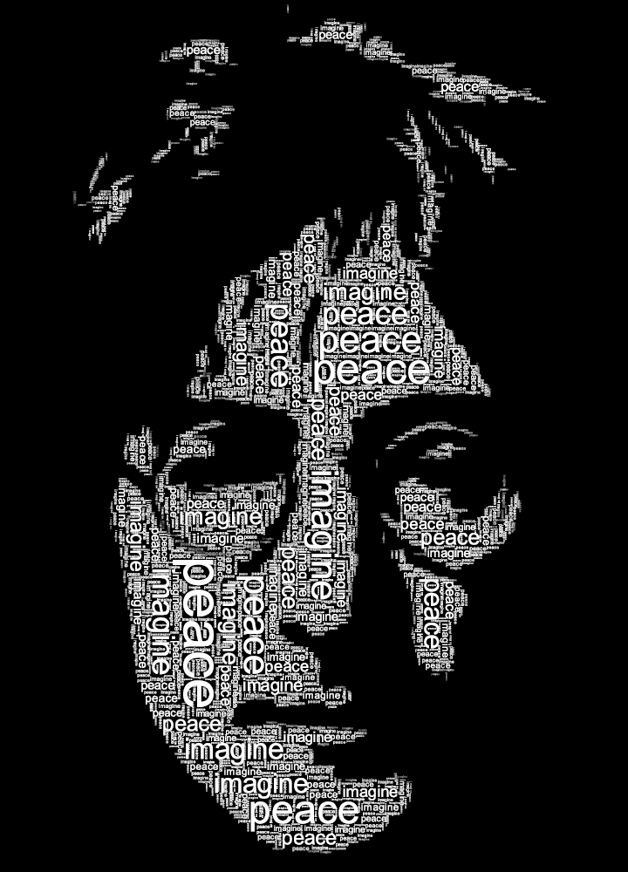

Slide 8
We’ll begin with the background:
Collage
  You can use printed words, you can use magazine words, you can collage a color…
Paint
  You can paint a simple color, paint over collage…
Allow to dry.

Slide 9
Let’s use a grid:
A grid will help us with proportion so you will look like you!
Draw your grid lightly so we can erase it later.
Label it A, B, C, etc. and 1, 2, 3, etc. This will help you match the boxes on your photo with the boxes on your canvas.

Slide 10
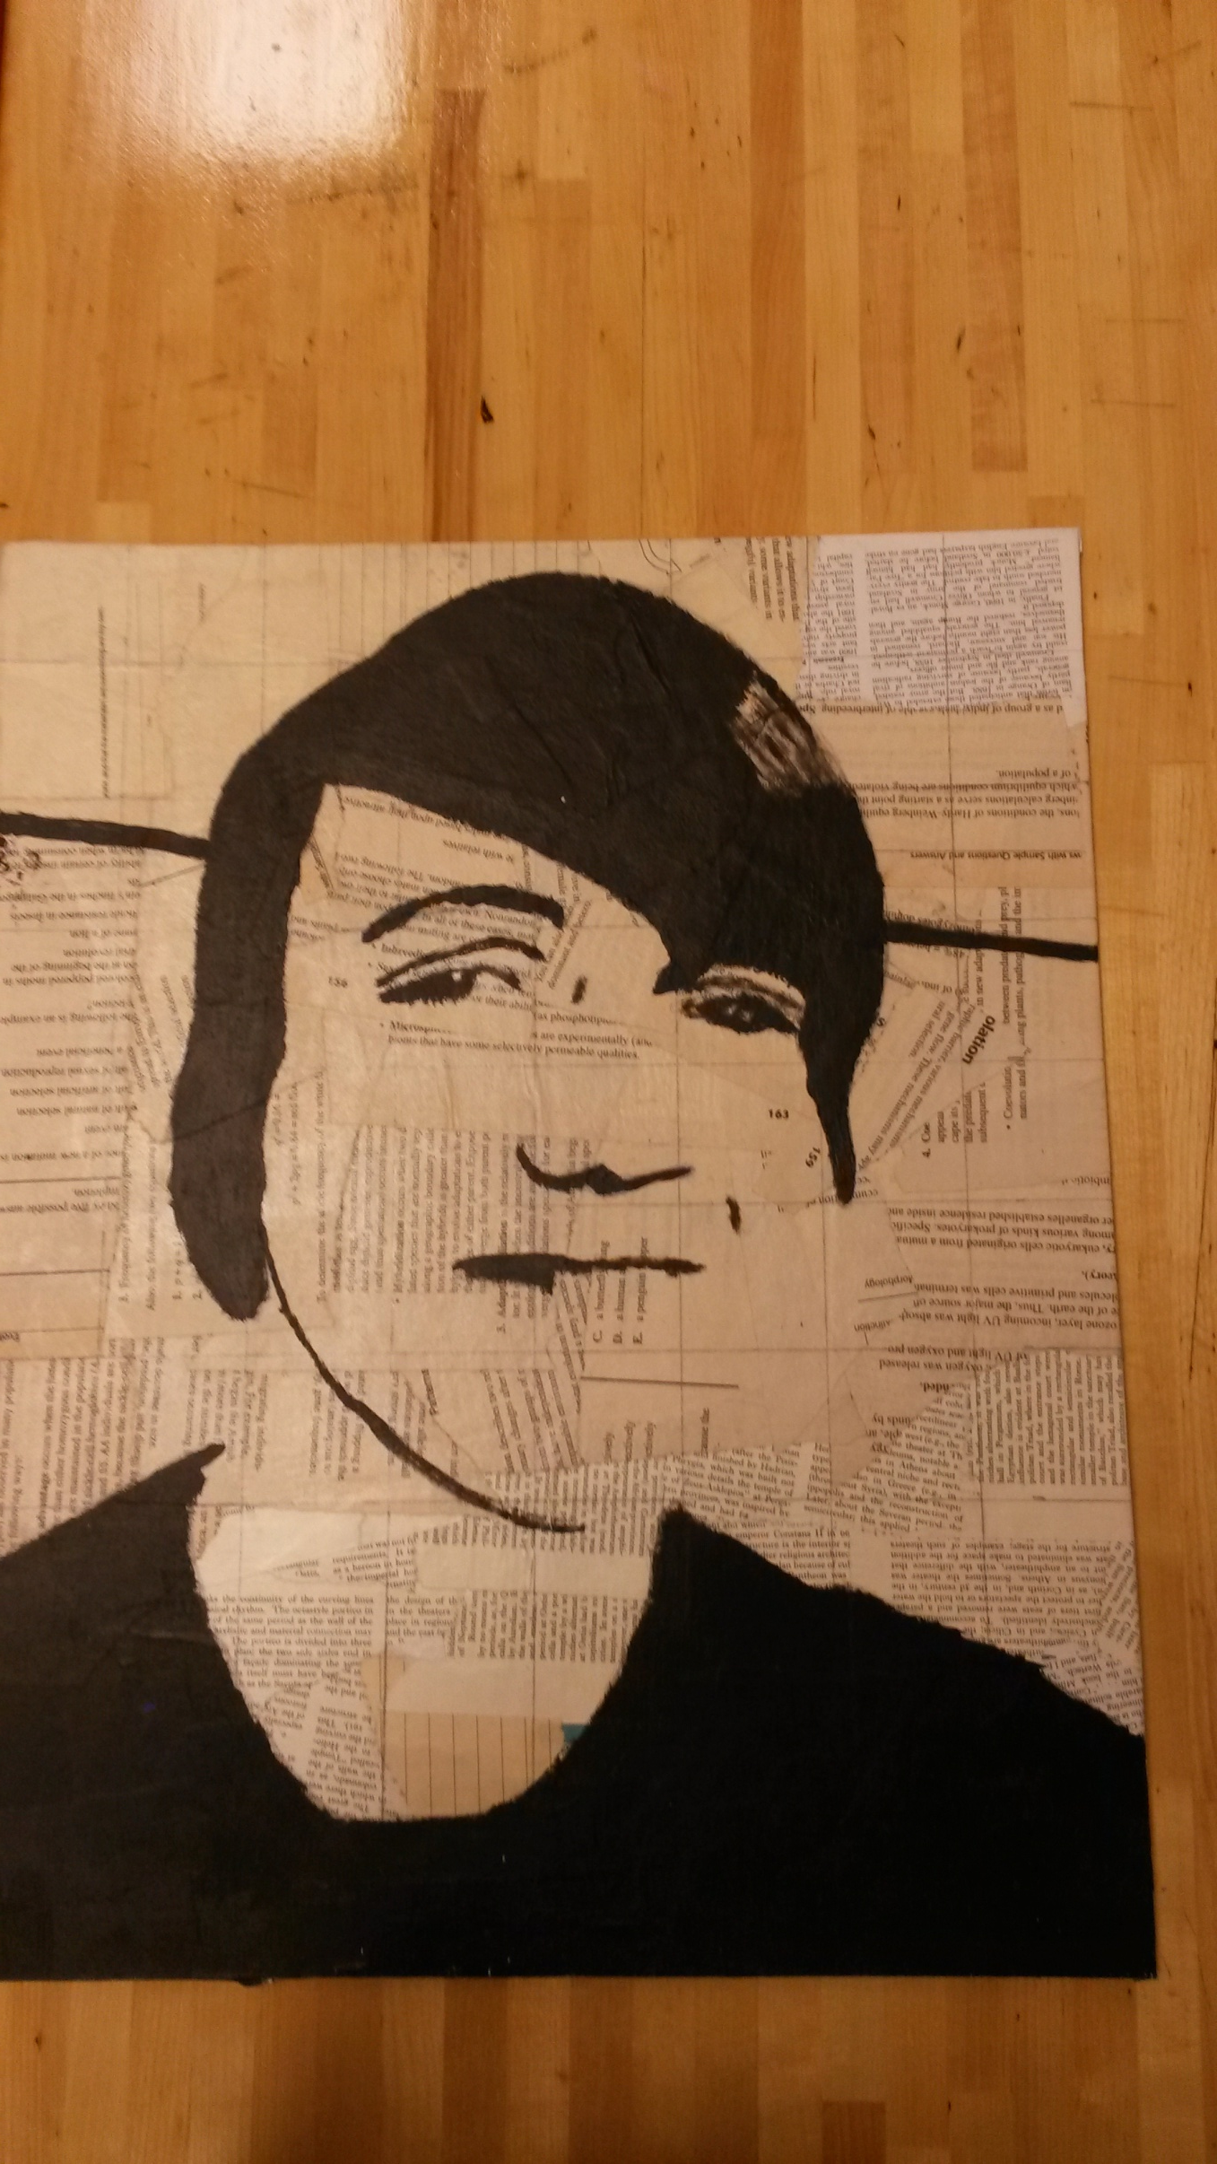

Slide 11
Draw yourself:
Use a pencil and draw lightly.
Focus on your outline first. Follow it from box to box.
Then, focus on details.
Use a pencil to color in the black area.

Slide 12
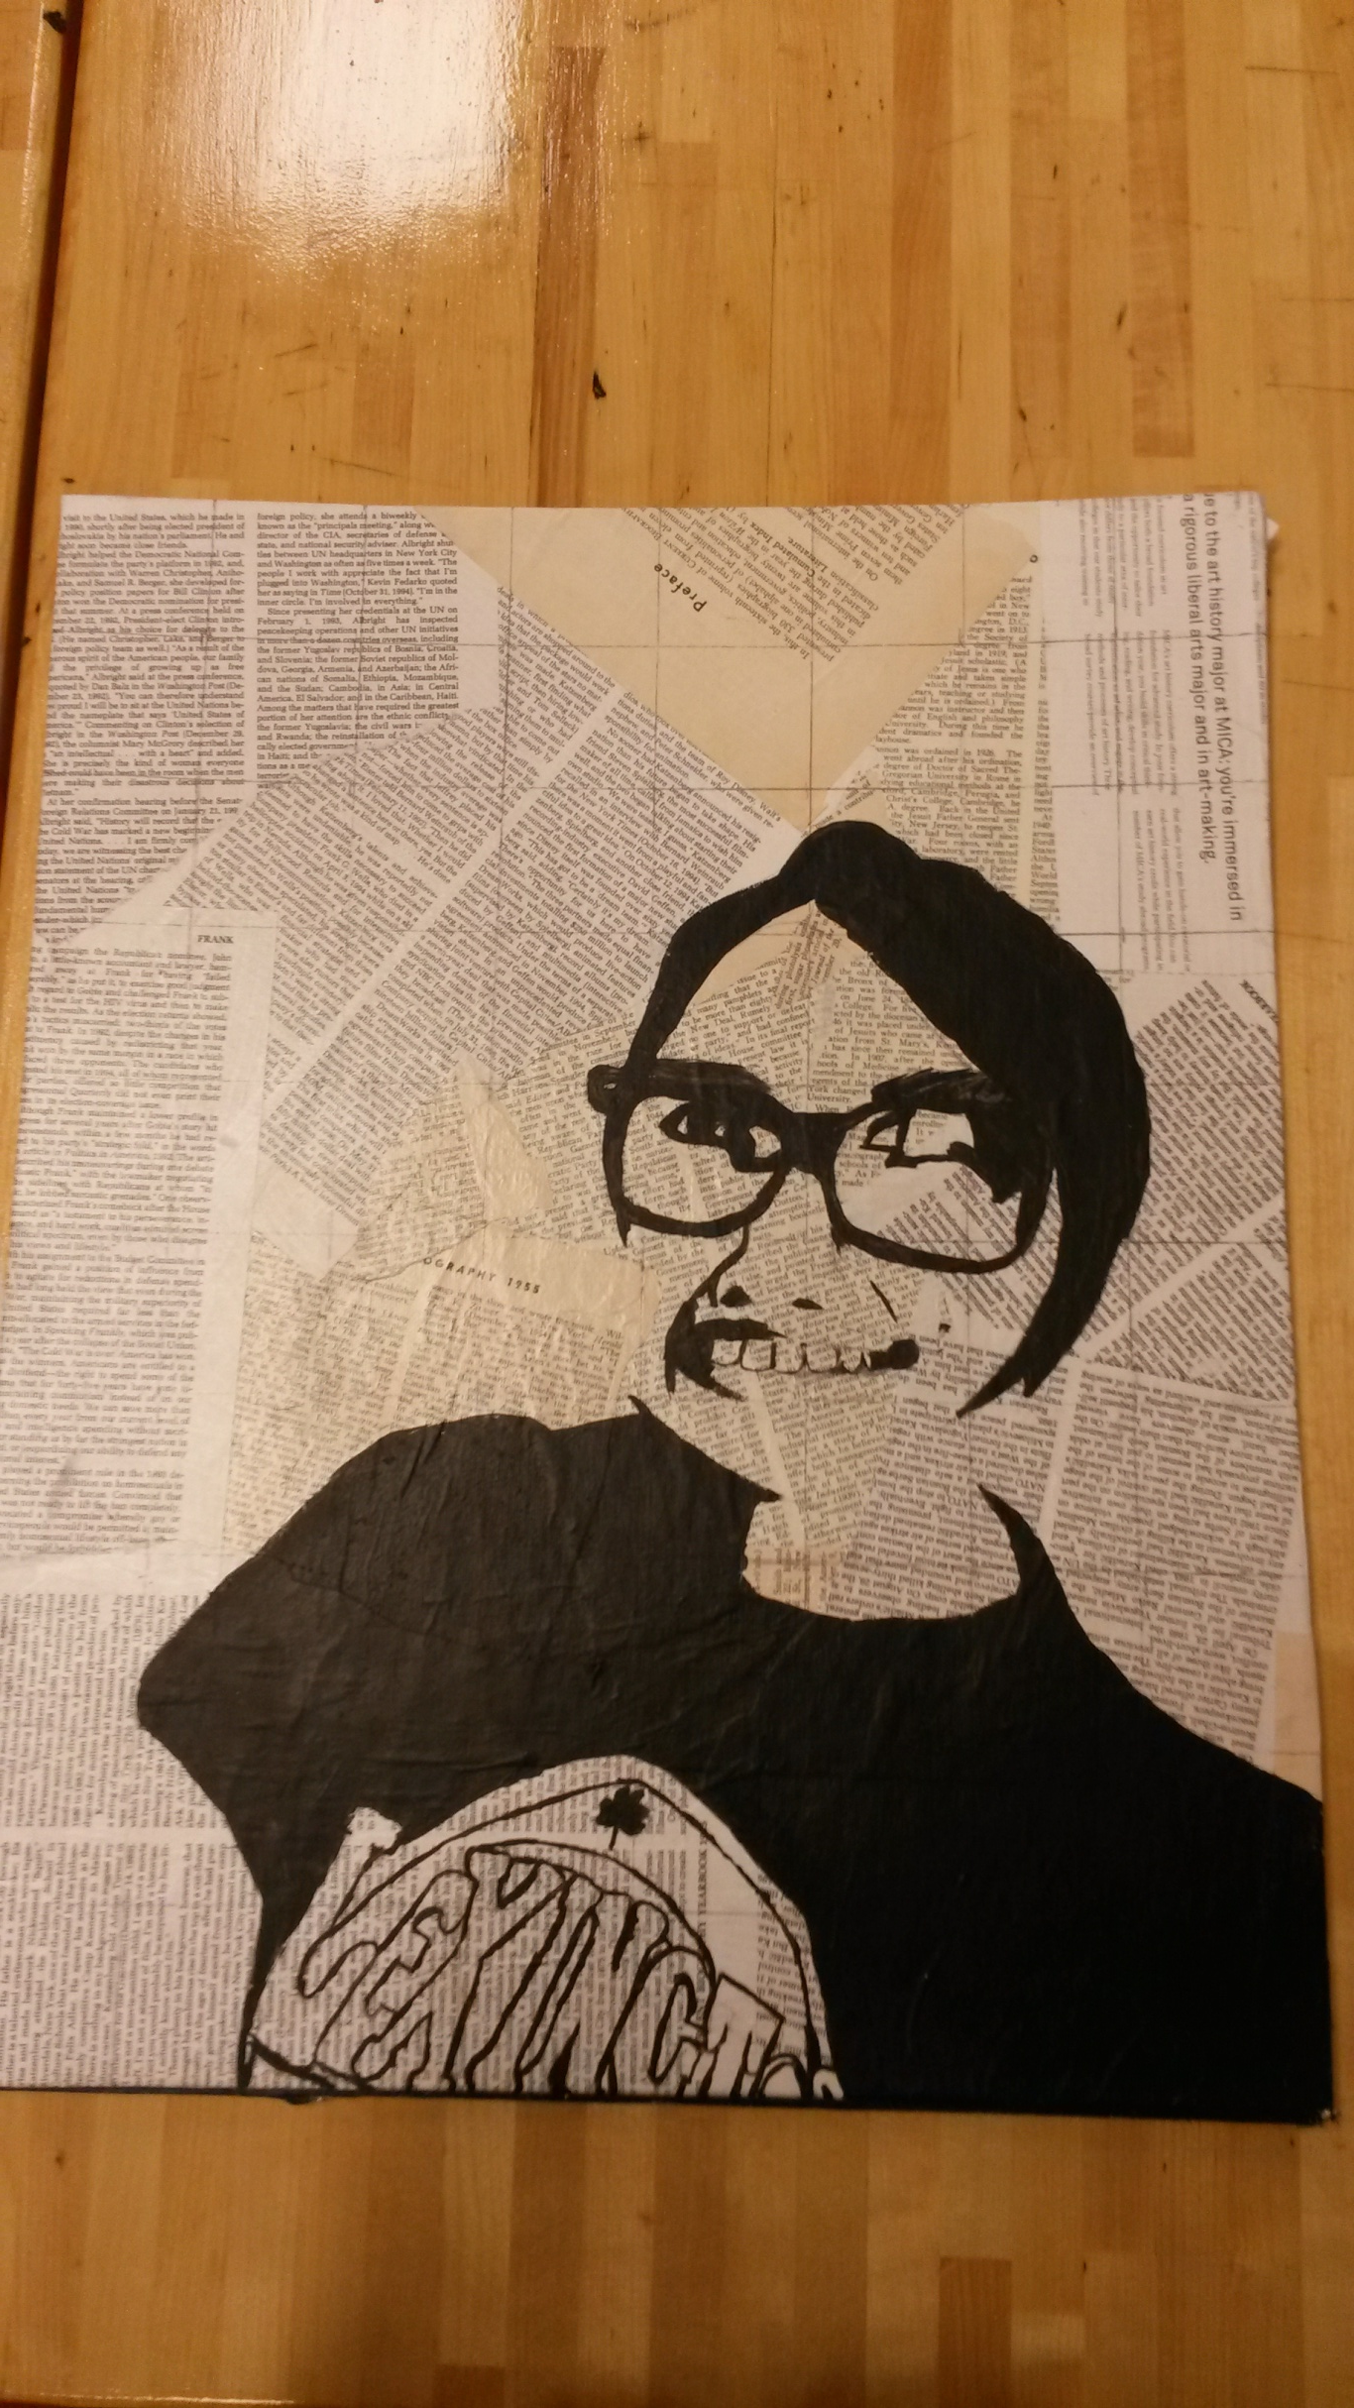

Slide 13
Erase!
Erase your grid lines. Be careful.
Have a friend double check that all lines have been fully erased.

Slide 14
Paint:
Use black paint to create high contrast.
Paint over your penciled in areas.
Take your time.
Keep edges smooth/clean.
Pay attention to small details.
I have a handful of super small brushes you may check out. Just ask.

